Slide 1
Red words
Reception
HOLY TRINITY C of E PRIMARY SCHOOL
GROWING TOGETHER AS CHILDREN OF GOD

Slide 2
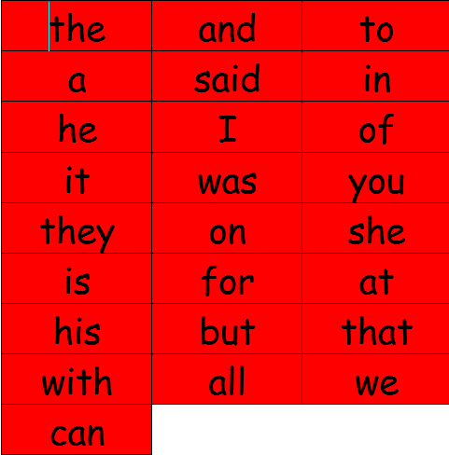
Set 1

Slide 3
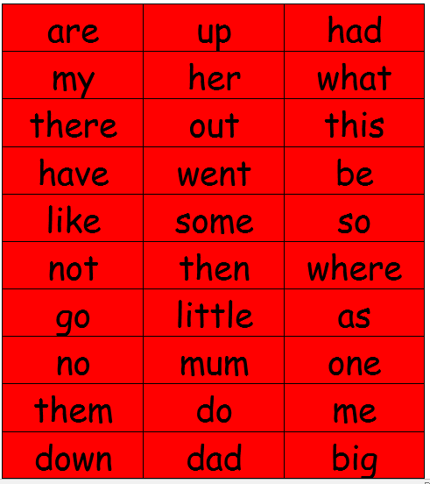
Set 2

Slide 4
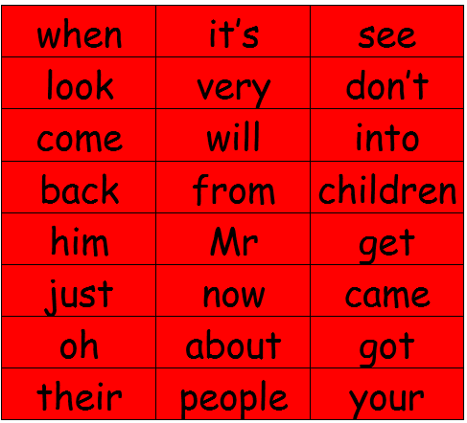
Set 3

