Slide 1

Year 4 Welcome Meeting
GROWING TOGETHER AS CHILDREN OF GOD

Slide 2
Year 4 Staff
4H Class Teacher: Miss McHenry (4½ days), Madame Poleviou (Tuesday morning)
4T Class Teacher: Miss Davies
Teaching Assistant: Mrs Hunt
Learning Support Assistant: Mrs Granger, Mrs Navqi, Miss Faugoo and Mrs Teodora
GROWING TOGETHER AS CHILDREN OF GOD

Slide 3
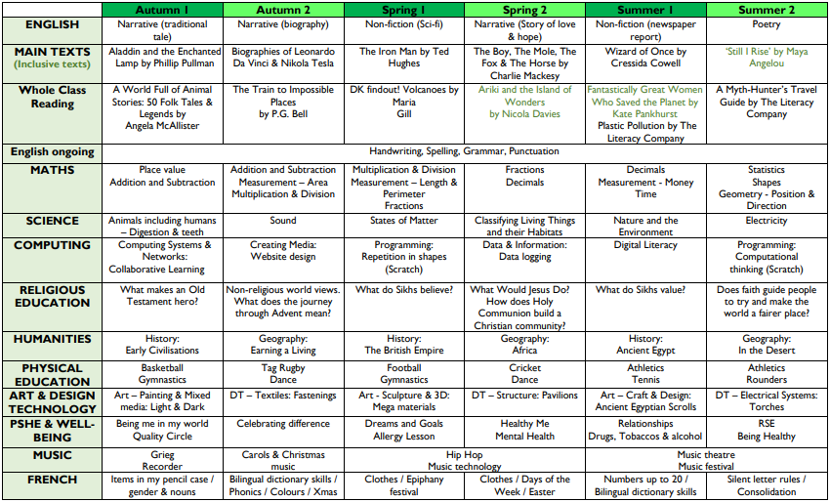
Long Term Plan
GROWING TOGETHER AS CHILDREN OF GOD

Slide 4
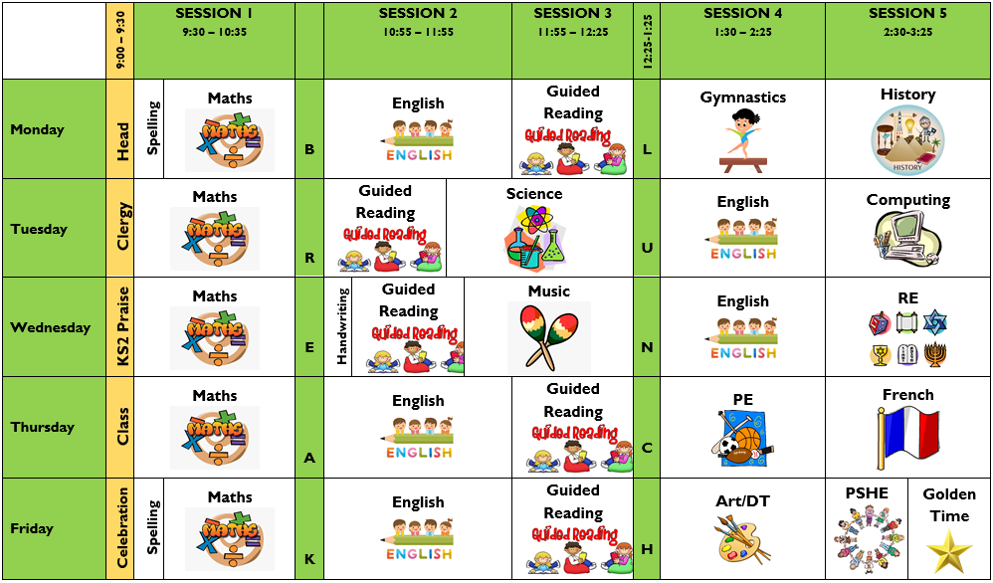
Timetable (4H)
GROWING TOGETHER AS CHILDREN OF GOD

Slide 5
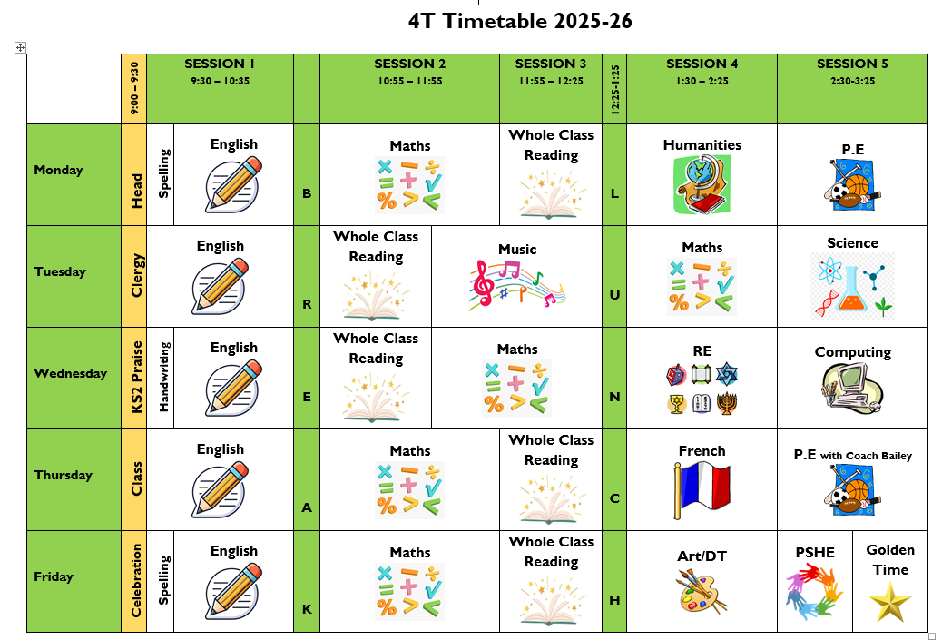
Timetable (4T)
GROWING TOGETHER AS CHILDREN OF GOD

Slide 6
Timings
Year 4
Start of day
8.45am
End of day
3.25pm
GROWING TOGETHER AS CHILDREN OF GOD

Slide 7
Equipment
Stationery Y3-6
Simple pencil case (Please do not send expensive pencil cases or those with ‘gadgets’ as these can be a distraction in the classroom and many of the gadget type pencil cases don't fit into the children's desks).
3 Simple HB pencils
2 Whiteboard Pens (ideally Show-me Fine/ Slim Drywipe Whiteboard Pen). These can be ordered on ParentMail from September if required.
Whiteboard rubber – example here
15cm ruler
30cm ruler
Small pair of scissors
Eraser
Basic pencil sharpener (not mechanical)
Pritt Stick (please buy the Pritt Stick brand as we know from experience that all others are less effective and do not last as long. This can be ordered on ParentMail if required. Please do not buy coloured glue as this shows through the paper in exercise books)
Colouring pencils (not smelly or glitter pencils)
Additional items for KS2:
3 black handwriting pens (e.g. Berol Handwriter or Frixion 0.7mm Rollerball NOT a biro) – KS2 only
2 Fluorescent highlighter pens – KS2 only
Oxford School Dictionary Paperback ISBN: 978-0192747105 (https://www.amazon.co.uk/Oxford-School-Dictionary/dp/019274710X or available from ParentMail at a cost of £5) – KS2 only
Oxford School Thesaurus (Paperback). ISBN 978-0192747112 (https://www.amazon.co.uk/Oxford-School-Thesaurus/dp/0192747118) – KS2 only
Equipment will need to be replenished throughout the year.
GROWING TOGETHER AS CHILDREN OF GOD

Slide 8
Equipment
Water Bottle
School or plastic sports bottle filled with water (not juice please)
Fruit/Veg Snack
A healthy snack for playtime. This should be a fruit or vegetable.
PE Kit
Children will need to wear the school’s official PE uniform which consists of branded black tracksuit top and trousers, along with their house t-shirt. Children can wear plain black shorts on warmer days.
Black plimsols/trainers and socks should also be worn.
No jewellery to be worn in PE including stud earrings.
Please make sure that all your child’s items are clearly labelled.
GROWING TOGETHER AS CHILDREN OF GOD

Slide 9
Uniform
Please ensure that your child comes to school in the correct school uniform at all times and that it is all named.
KS2 children can wear white polo shirts all year round, instead a shirt and tie.
They can wear their PE kit on PE days or days they have a Holy Trinity school sports club.
We have a lost property box in the Welcome Area for any stray items we find.
Long hair needs to be tied up.
No jewellery or nail varnish should be worn to school except for a watch and/or stud earrings.
GROWING TOGETHER AS CHILDREN OF GOD

Slide 10
Home Learning
All Home Learning information and tasks/activities will be uploaded to the Learning Platform. Each child has their own log-in for this. It is important that you regularly look at the Learning Platform Class page, as this will give key information about the curriculum your child is learning.
KS2 Additional Home Learning
• All of the additional Home Learning is optional, but it is useful to enable the children to consolidate what they have been learning in class that week.
• In addition to the weekly information on the Learning Platform, the Home Learning will give parents/carers more of an insight into what their child has been taught that week.
• It is intended that parents/carers will engage with their child/children whilst they are completing their Home Learning.
• The additional work will be uploaded on the Learning Platform (each child has their own log-in details) every Friday.
• The additional work may sometimes be a sheet with questions, a quiz to complete online or a piece of writing.
• The Home Learning is for home use only. Answers to any questions will usually be uploaded the following Friday, which will give parents/carers a chance to see how well their child has understood their work. Occasionally answers may be uploaded when the work is uploaded.
• The Home Learning should not be brought into school.
• Optional: Maths Home Learning Journal (Year 1 – Year 6) – A separate Parentmail has been sent with more information.
GROWING TOGETHER AS CHILDREN OF GOD

Slide 11
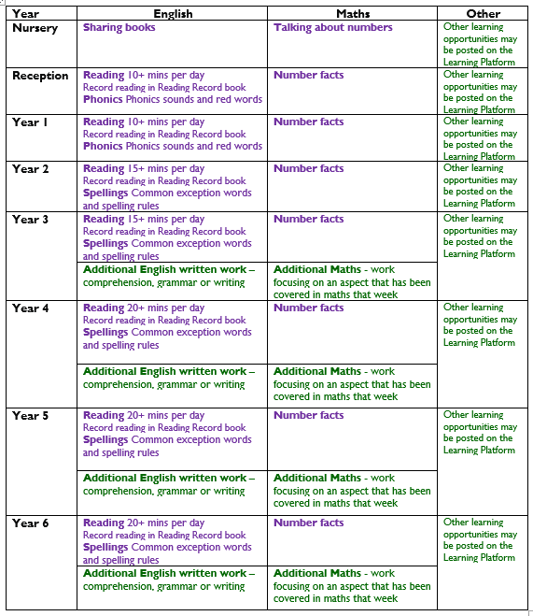
Home Learning
We propose the following weekly
Home Learning schedule:
All of the above written in purple is priority learning and should be completed by all children.
Everything in green is additional learning, and is optional.
GROWING TOGETHER AS CHILDREN OF GOD

Slide 12
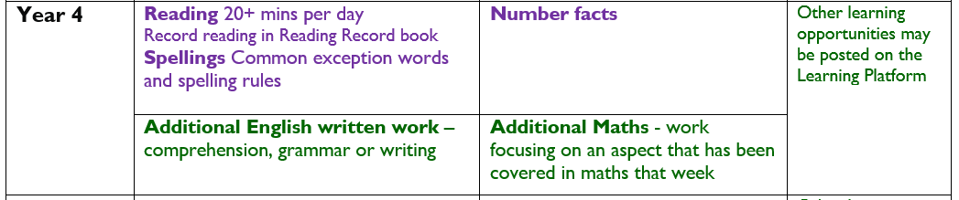
Home Learning
times tables!
All of the above written in purple is priority learning and should be completed by all children.
Everything in green is additional learning, and is optional.
GROWING TOGETHER AS CHILDREN OF GOD

Slide 13
Reading
Children should be reading for at least 15 minutes each day either independently or with an adult. This includes shared reading and being read to.
In Year 4, children will continue to use their their Year 3 Reading Record.
The expectation is that you record your child's reading once a week and sign/initial. Children should then record their reading independently two times a week.
Any books can be recorded, not just school books.
Children will be given opportunities, throughout the week, to take AR reading book quizzes and to go to the library to change their Accelerated Reader book and Free Reader book.
Accelerated Reader book codes will change when needed and pupils will be made aware of this. Book codes are decided using several means: the quizzes pupils take after reading a book, termly assessments plus teachers observations and professional judgement.
It is important that children see reading as a pleasurable experience. Let them see you reading for pleasure!
GROWING TOGETHER AS CHILDREN OF GOD

Slide 14
Spelling
Y3-6
Children will learn a pattern/rule every two weeks. They will complete numerous spelling activities across the two weeks and then have the opportunity to apply these spelling rules every other Friday which will be checked.
There will be no spelling lists on the website but a selection of example words from that week’s patter/rule will be added.
Please practise common words (Red Words) regularly at home; use strategies that work for your child to help them learn these words e.g. look/cover/write/check, using for handwriting practice, flashcards, magnetic letters…
Encourage children to think for themselves first before asking you to spell a word – remind them of strategies they can use such as sounding the word out and thinking about other words they know with a similar pattern. Encourage the use of a dictionary where appropriate.
When your child has finished their home learning there is no need for you to correct all spelling mistakes but you could point out some spellings that you know they have been practising.
GROWING TOGETHER AS CHILDREN OF GOD

Slide 15
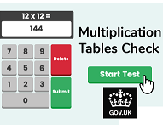
Year 4 Multiplication Check
The national times table check is a test for all year four pupils that takes place in June. The purpose of the check is to determine whether your child can fluently recall their times tables up to 12, which is essential for future success in mathematics.
It is an on-screen check consisting of 25 times table questions. Your child will be able to answer 3 practice questions before taking the actual check. They will then have 6 seconds to answer each question. On average, the check should take no longer than 5 minutes to complete.
When we receive the results, we will share them with the you and the children in their end of year reports. There is no pass mark.
We focus on times tables at least once a week in class, (twice a week in the lead up to the test) using a range of online programmes. There is an abundance of resources online which children can use at home, so please encourage your child to practice - they all have log in details for TTRS and Sumdog.
GROWING TOGETHER AS CHILDREN OF GOD

Slide 16

Behaviour
Positive behaviour will always be praised.
Each week children will have the opportunity to earn house points etc. for effort or behaviour.
Sometimes yellow and red cards will need to be used, this will always be in line with the Belonging and Behaviour Policy.
Parents will be contacted during the school day if their child has received a red card. Red cards are recorded in the classroom behaviour log.
GROWING TOGETHER AS CHILDREN OF GOD

Slide 17
Assessment
The school (Year 1-6) holds 3 formal assessment sessions throughout the year. These are usually held towards the end of each term. Children will be formally assessed in Reading, Writing, Grammar/Punctuation/Spelling and Maths. Teachers then use these assessments to inform their judgements of your child’s attainment. These judgements are shared with parents, either verbally or in written form.
For each year group a child might be working:
Below age-related expectations (children are likely to be working 2 terms+ below ARE)
Towards age-related expectations (children are working just slightly below ARE)
At age-related expectations
Above age-related expectations (children are working at greater depth)
NB A child working above ARE in one year group may not necessarily still be working above ARE in the next year group due to the increased demands of the curriculum in that year group.
GROWING TOGETHER AS CHILDREN OF GOD

Slide 18

School Website
https://www.holytrinity.merton.sch.uk/web
You can access
Policies
Health & Wellbeing support
Information on the Curriculum being taught at Holy Trinity
GROWING TOGETHER AS CHILDREN OF GOD

Slide 19

Learning Platform
https://www.holytrinity.merton.sch.uk/web
Login in to access you children’s class page.
Here you will find information on:
What your child will be learning
Class information/notices
The Long Term Plan
Spellings
Curriculum support materials to use at home
Sumdog and TTRS Competitions
Please check this once a week!
GROWING TOGETHER AS CHILDREN OF GOD

Slide 20
Parent/Teacher
Share My Learning will take place once every half term.
This is an opportunity to share children’s learning and progress.
Parents Evening will continue to be online.
It is essential that you communicate with the office and/or teacher ahead of time if you cannot make your appointment.
GROWING TOGETHER AS CHILDREN OF GOD

Slide 21
Contacting the School
Daily short interaction with class teacher
Meetings for more significant concerns
Parent Teacher Consultations (first one in autumn)
Please help us by following the guidance on the following slides (will be sent by email) e.g. don’t copy in unnecessary people to emails

Slide 22
Year Group Emails
Each year group has a team email for contacting the class teachers. Please direct any class teacher emails to the following email address:
year4@holytrinity.merton.sch.uk
These emails will go to the class teachers within the year group, the Phase Leader, the SENDCo Mrs Moran, the Deputy Head Miss Hann and Headteacher Mrs Rickards.
If the information is confidential or sensitive please send this directly to either Mrs Rickards, Miss Hann or Mrs Moran as appropriate and they will share the information where necessary.
Please ensure that the subject of the email starts with the class. i.e.
4H – Child’s Name - subject
Reminder:
All functional messages related to uniform, pick ups, appointments, lost property etc. should still be directed to the school office email info@holytrinity.merton.sch.uk. You do not need to copy team email addresses into these.

Slide 23
How to Contact School Staff
Parents and carers often ask us for the best way to contact the school staff so we have put together the information below:
To…. | Please….
report a child absent… | phone or email the school office (not class teacher) by 8.45am or use ParentMail
tell us that you plan to pick up a child early… | phone or email the school office (not class teacher) by 8.45am
tell us that your child is not going to After School Club… | phone or email the school office by 8.45am
tell us that your child is going home with someone else… | email the class teacher by 8.00am (in an emergency, phone the school office during the school day)
deliver forgotten items to children during the school day… | bring items to school office. Items will be delivered to children when convenient
ask for help with ParentMail messages and payments e.g. lunches… | phone or email the school office
ask the teacher a quick question or communicate a short piece of information (less than 1 minute)… | speak with the teacher/ teaching assistant at drop off/ pick up
communicate a longer piece of information (more than 1 minute)… | email the class teacher (if applicable we will respond within 2 working days)
arrange a meeting with the teacher…. | email the class teacher (we will reply to the email within 2 working days and meet ASAP)
speak with Mrs Rickards…. | pop into the school office and she will meet you if she is free. Or email to arrange a meeting
buy school uniform….. | make and pay for an order on ParentMail and we will send the items home with your child
look for lost property…. | look in the blue lost property bin (outside the door opposite the Year 1 block) at drop off or pick up time. Small items such as watches are stored in the school office
find out about HOTS events e.g. school disco or quiz night and how to buy tickets… | read the HOTS newsletters/ emails which are sent out via Class Reps or contact HOTS directly

Slide 24
Useful Contacts
School telephone number: 020 8542 1591
Office email: info@holytrinity.merton.sch.uk
After School Club email: afterschoolclub@holytrinity.merton.sch.uk
Breakfast Club email: tc@holytrinity.merton.sch.uk
Izzy Rickards’ email: headteacher@holytrinity.merton.sch.uk
Class Teachers’ emails: year4@holytrinity.merton.sch.uk
Governors’ email: governors@holytrinity.merton.sch.uk
HOTS email: hotsemail@gmail.com

Slide 25

PGL
This 2 night trip is provisionally booked for 6th - 8th May.
It is an action packed 3 days (2 nights) when the children participate in a range of challenging outdoor activities. There is a display in the corridor that you can see which will give you an idea!
You will receive a communication via ParentMail before the end of the month and there is an option to pay in instalments. We would love every child to attend as it is so rewarding, so if finances are an issue, please let us know as the school can help.
We will hold a meeting with you all beforehand to give you the finer details and will provide you with a list of things to pack.
GROWING TOGETHER AS CHILDREN OF GOD

Slide 26

Thank you for your continued support
Questions
GROWING TOGETHER AS CHILDREN OF GOD

