Slide 1

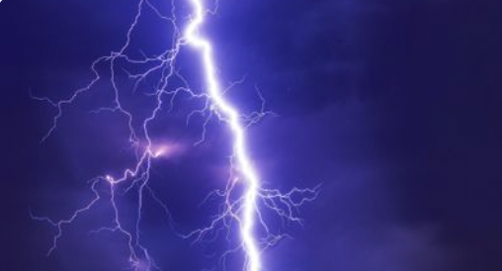

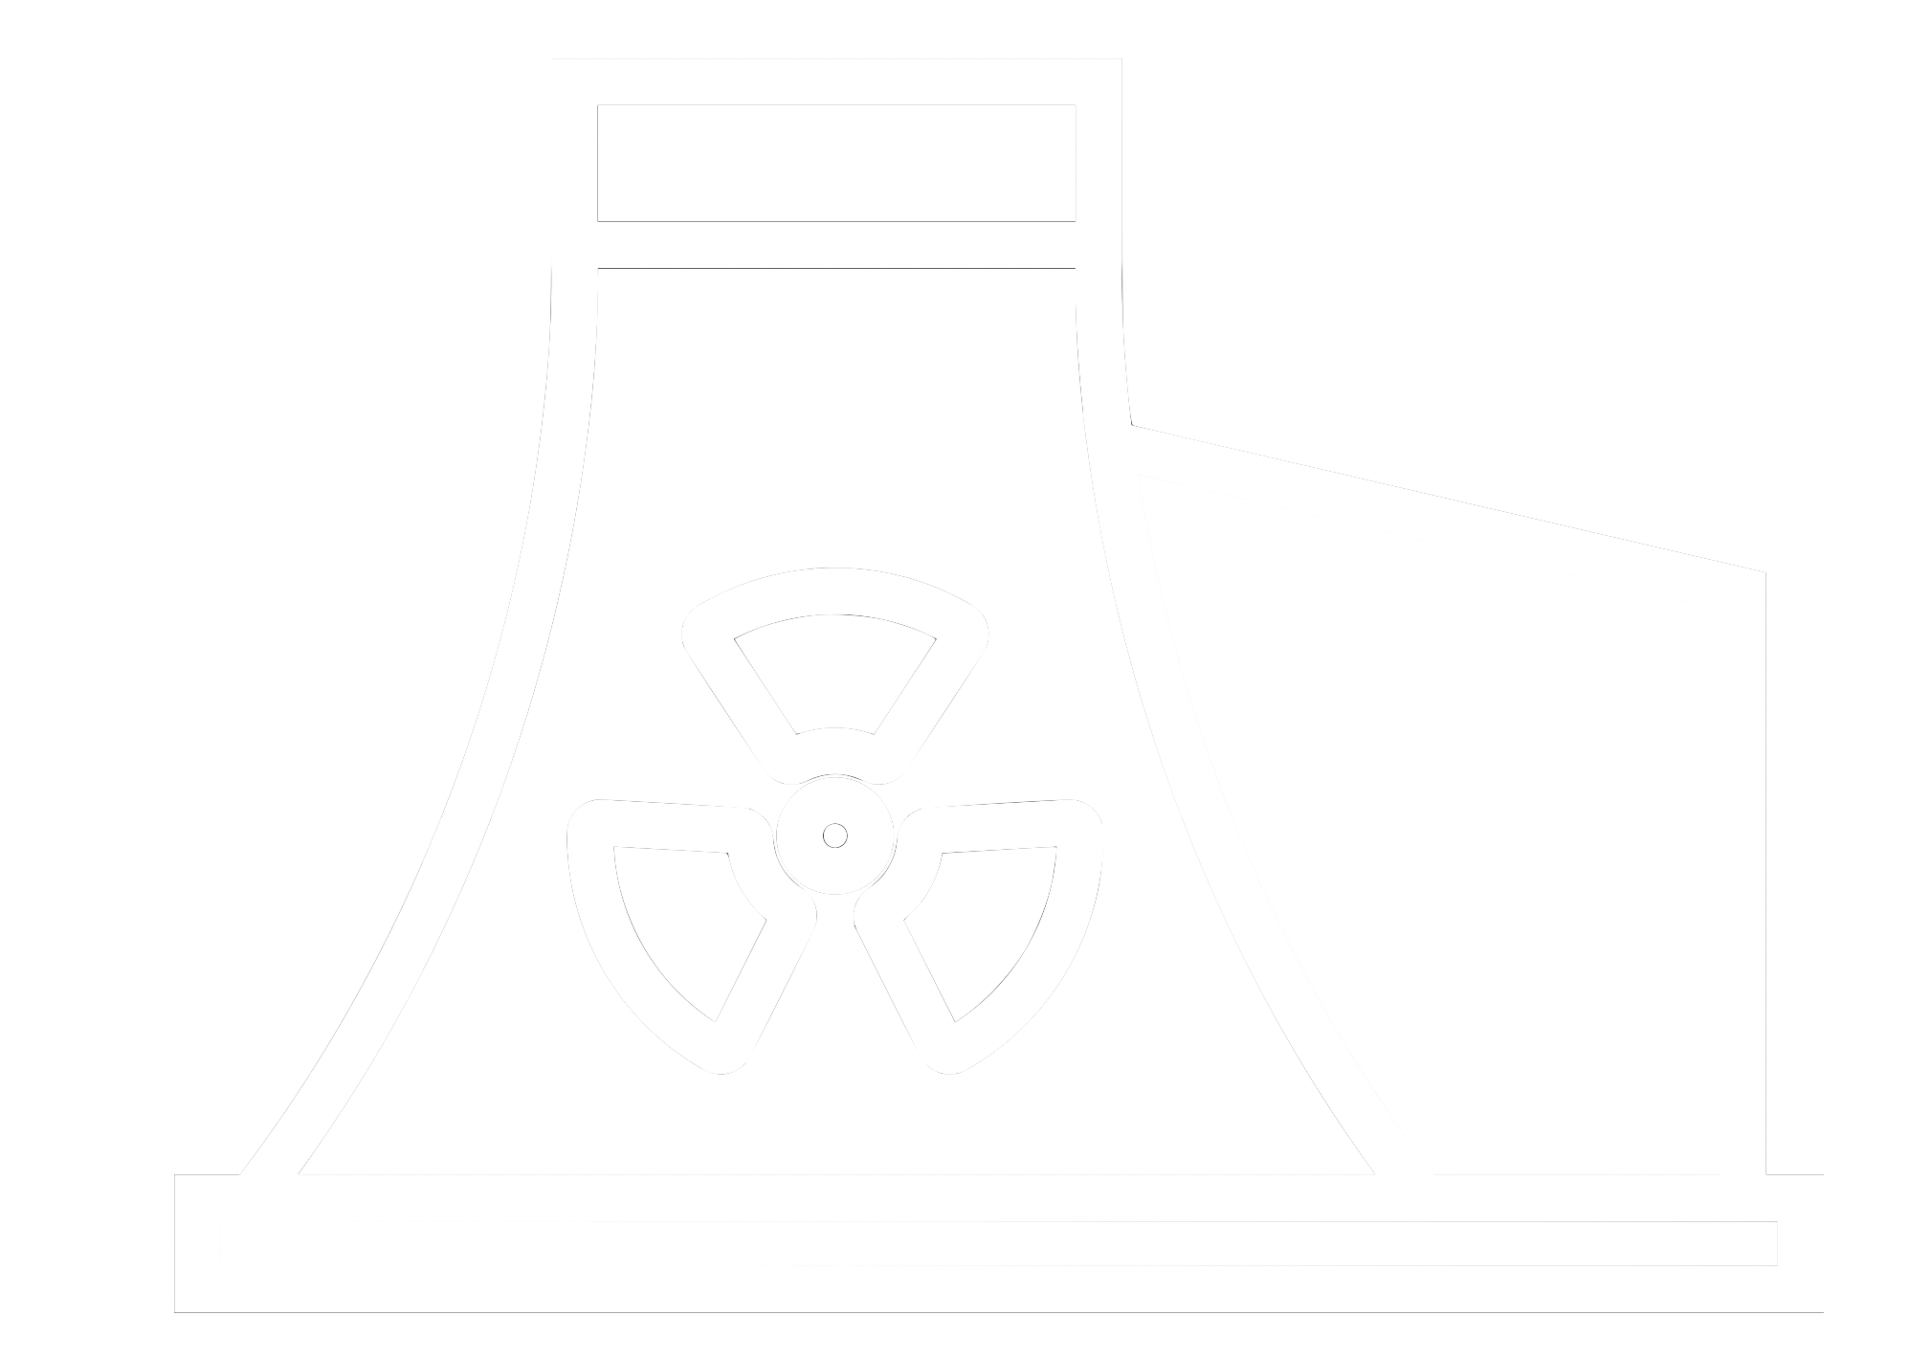
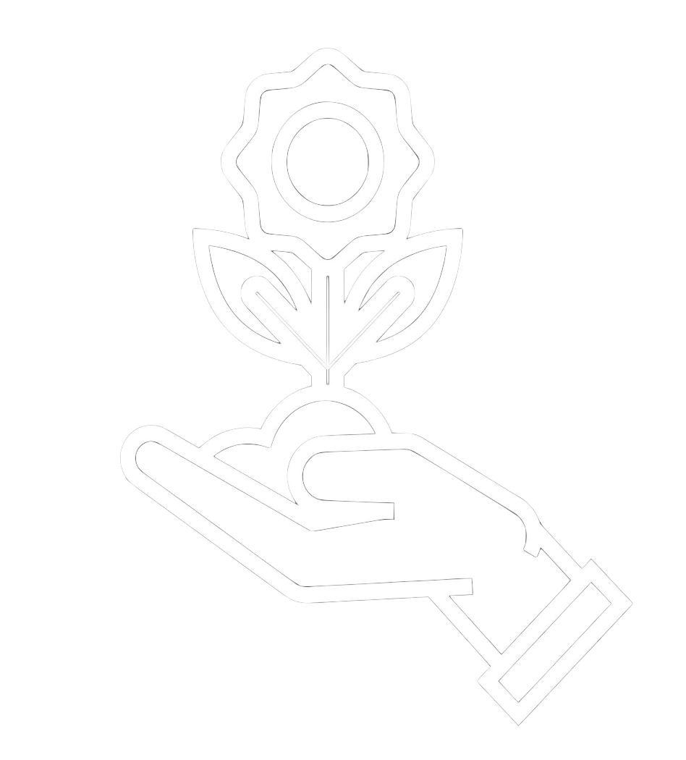









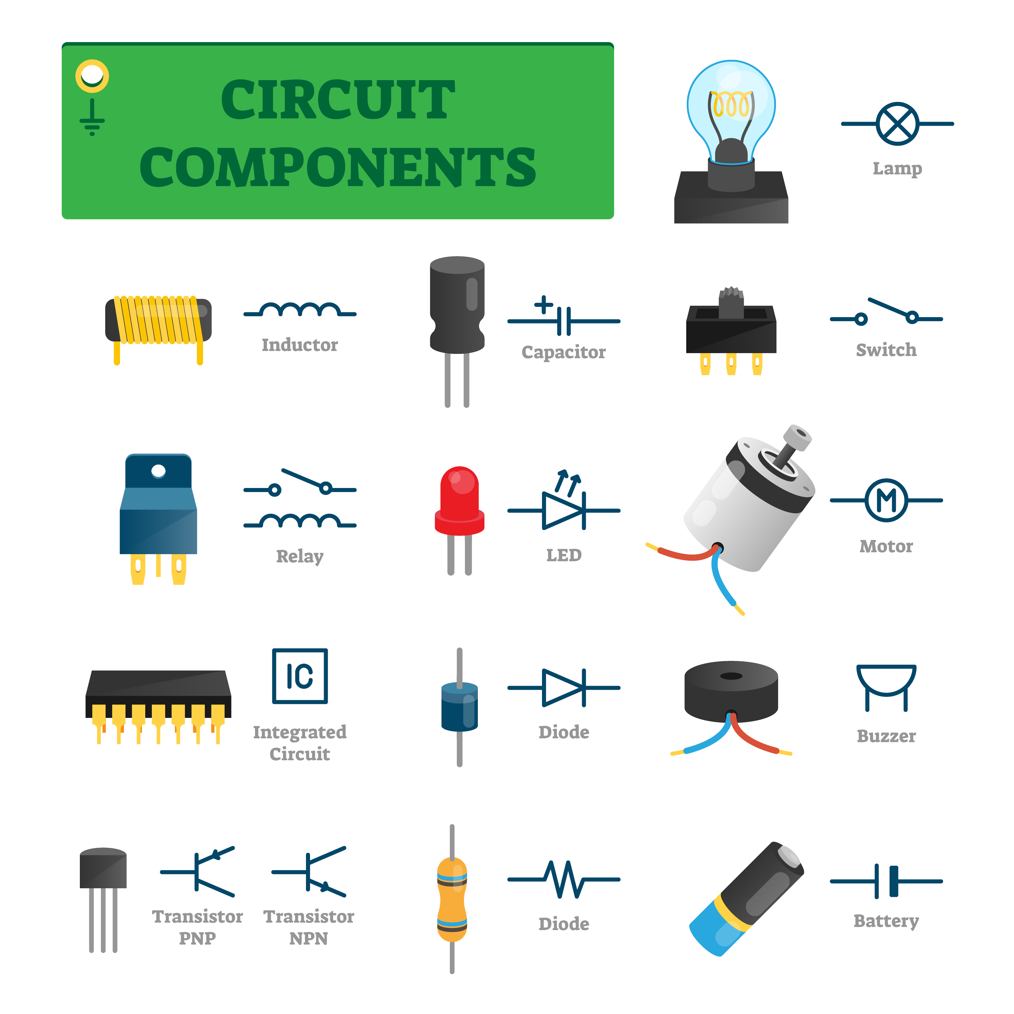
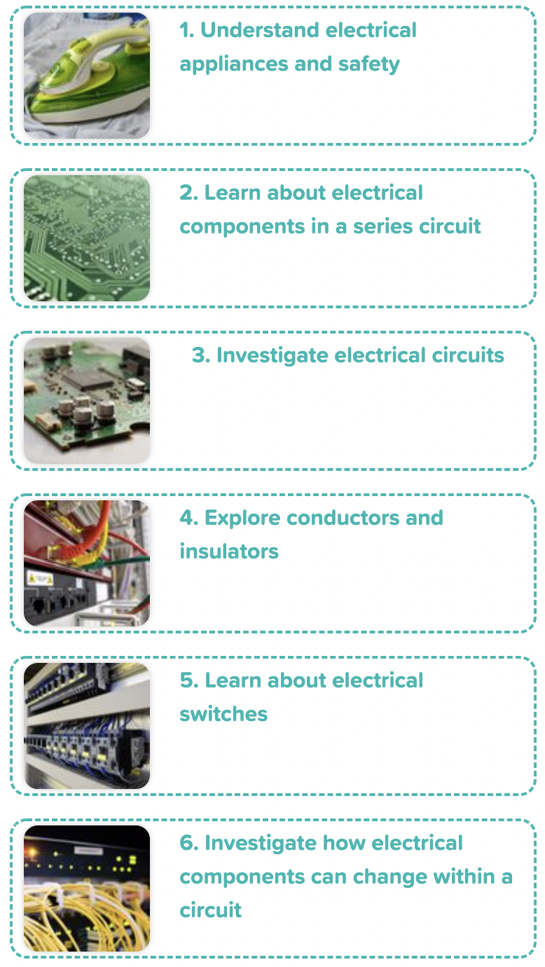


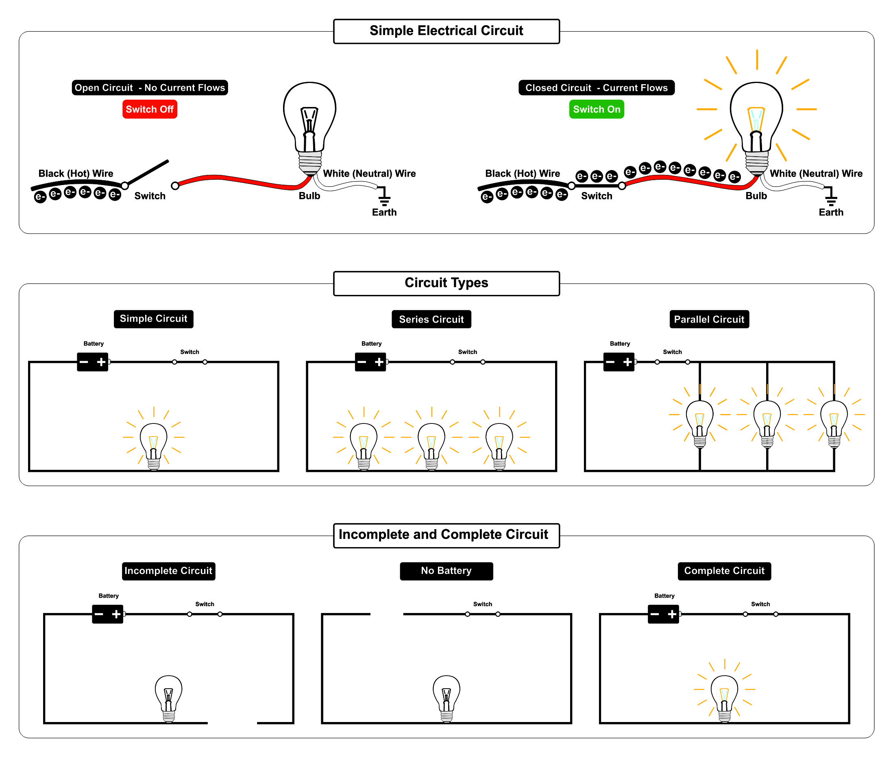
Careers connected to electricity:
electrician, electrical engineer
Knowledge Organiser: Year 4 - Electricity
Careers connected to the human body:
doctor, nurse, massage therapist, personal trainer, theatre technician
Key Facts
Conductors and Insulators
Electrical Components
Lesson Sequence
• Materials that allow electricity to pass through to create a complete circuit are called electrical conductors.
• Materials that do not allow electricity to pass through and do not complete a circuit are called electrical insulators.
A circuit contains a battery (cell), wires and a component that requires electricity to work (bulb, motor or buzzer).
Electrical current flows through the wires from the battery (cell) to the bulb, motor or buzzer.
A switch can break or reconnect a circuit.
A switch controls the flow of the electrical current around the circuit. When the switch is off, the current cannot flow. This is not the same as an incomplete circuit.
conductors
1. Understand electrical appliances and safety
steel
copper
2. Learn about electrical compounds in a series circuit
insulators
wood
plastic
3. Investigate electrical circuits
Simple Circuit
A complete circuit is a loop that allows electrical current to flow through wires.
4. Explore conductors and insulators
Simple Electrical Circuit
These are complete circuits - they have a battery (cell) and a component (bulb). The wires are placed in the right places of the battery for the circuit to work.
5. Learn about electrical switches
6. Investigate how electrical components can change within a circuit
These circuits will not work as they are incomplete.
Developing Experts Copyright 2022 All Rights Reserved

