Slide 1

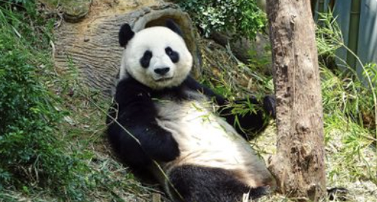
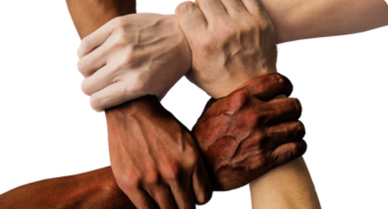
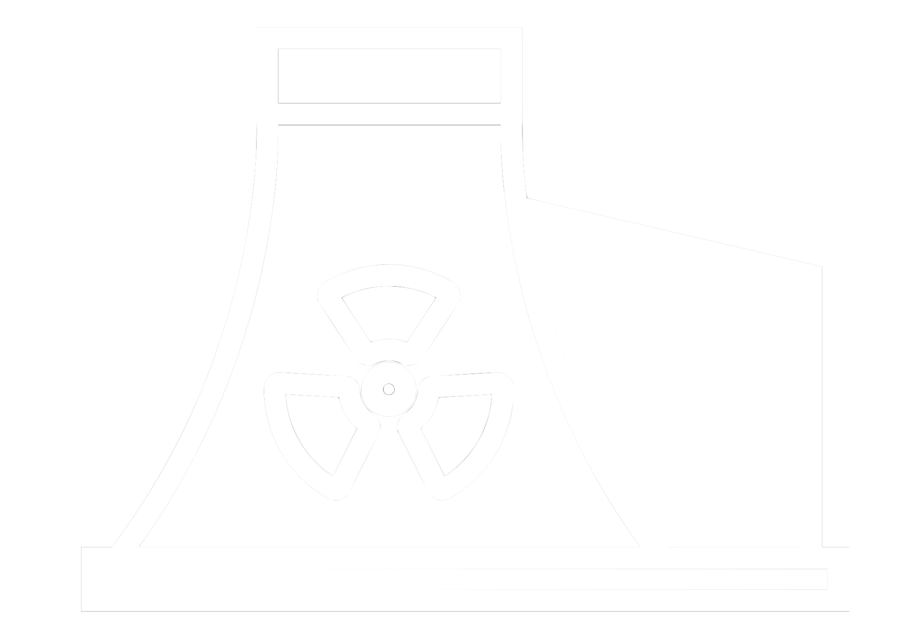








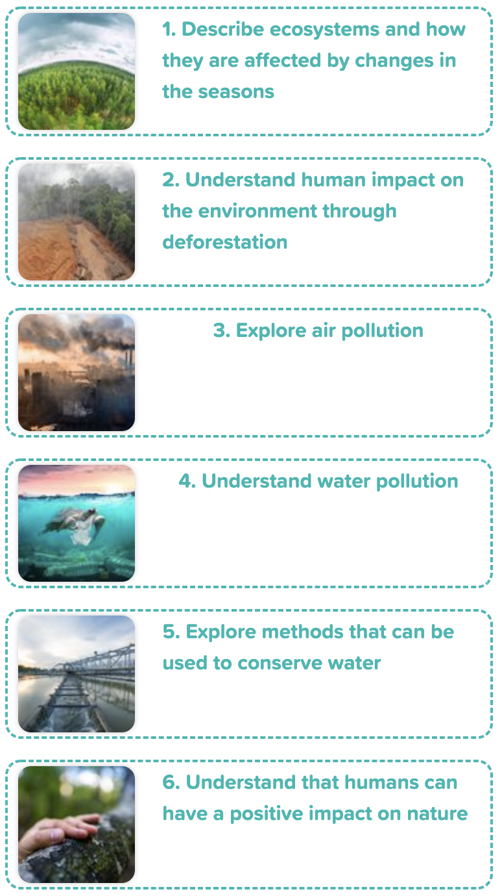
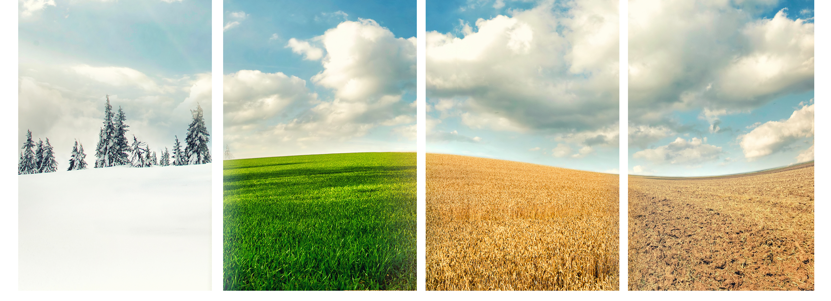
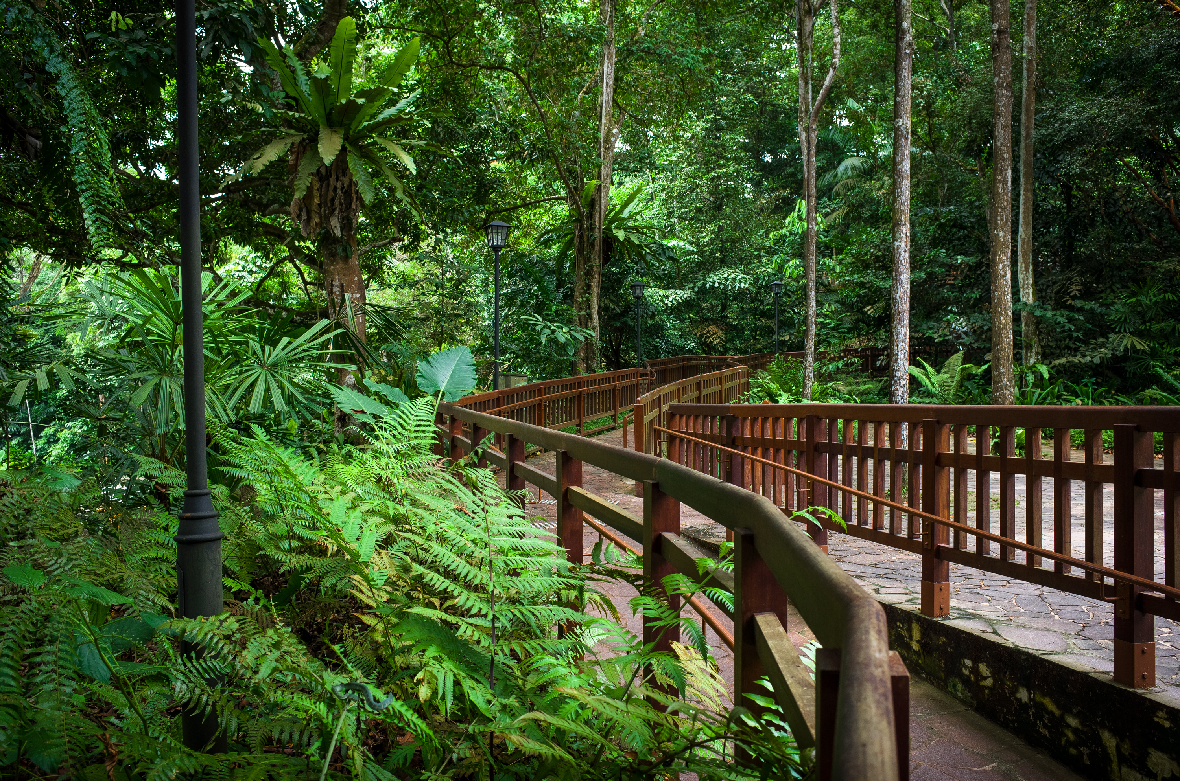
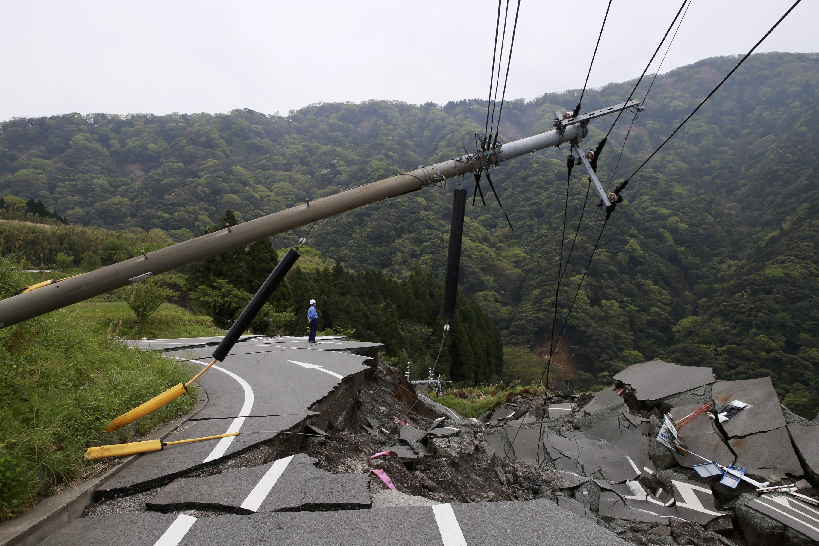
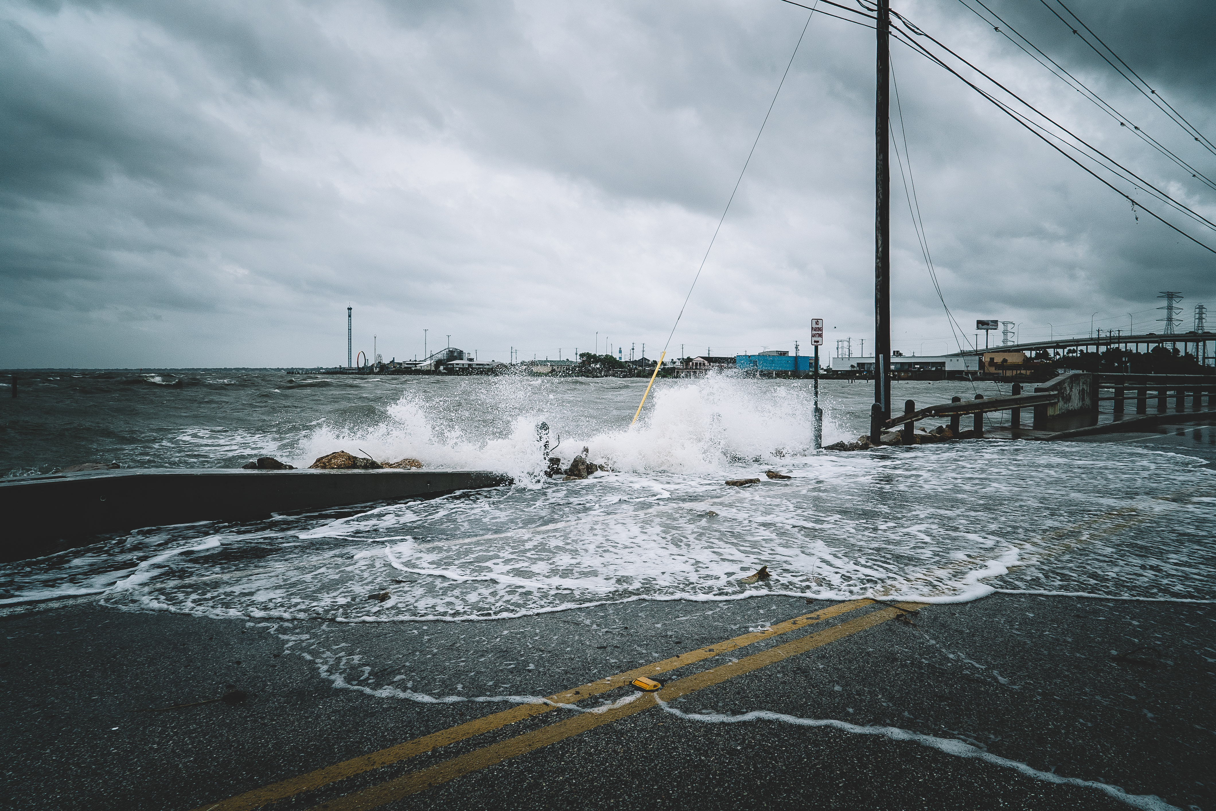
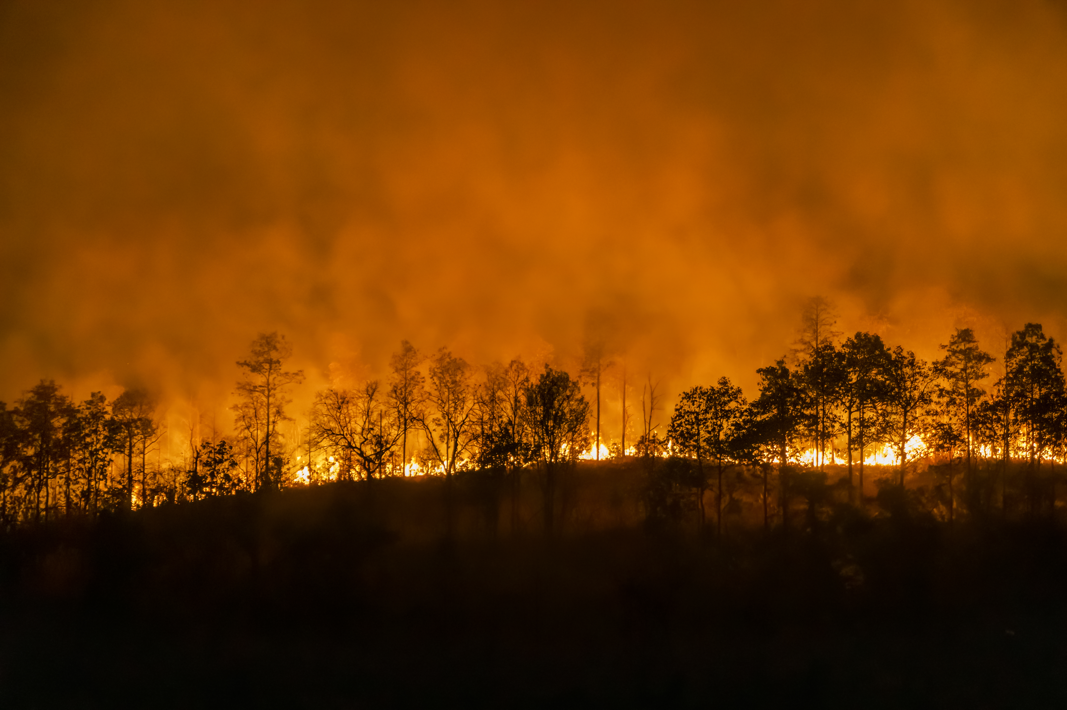
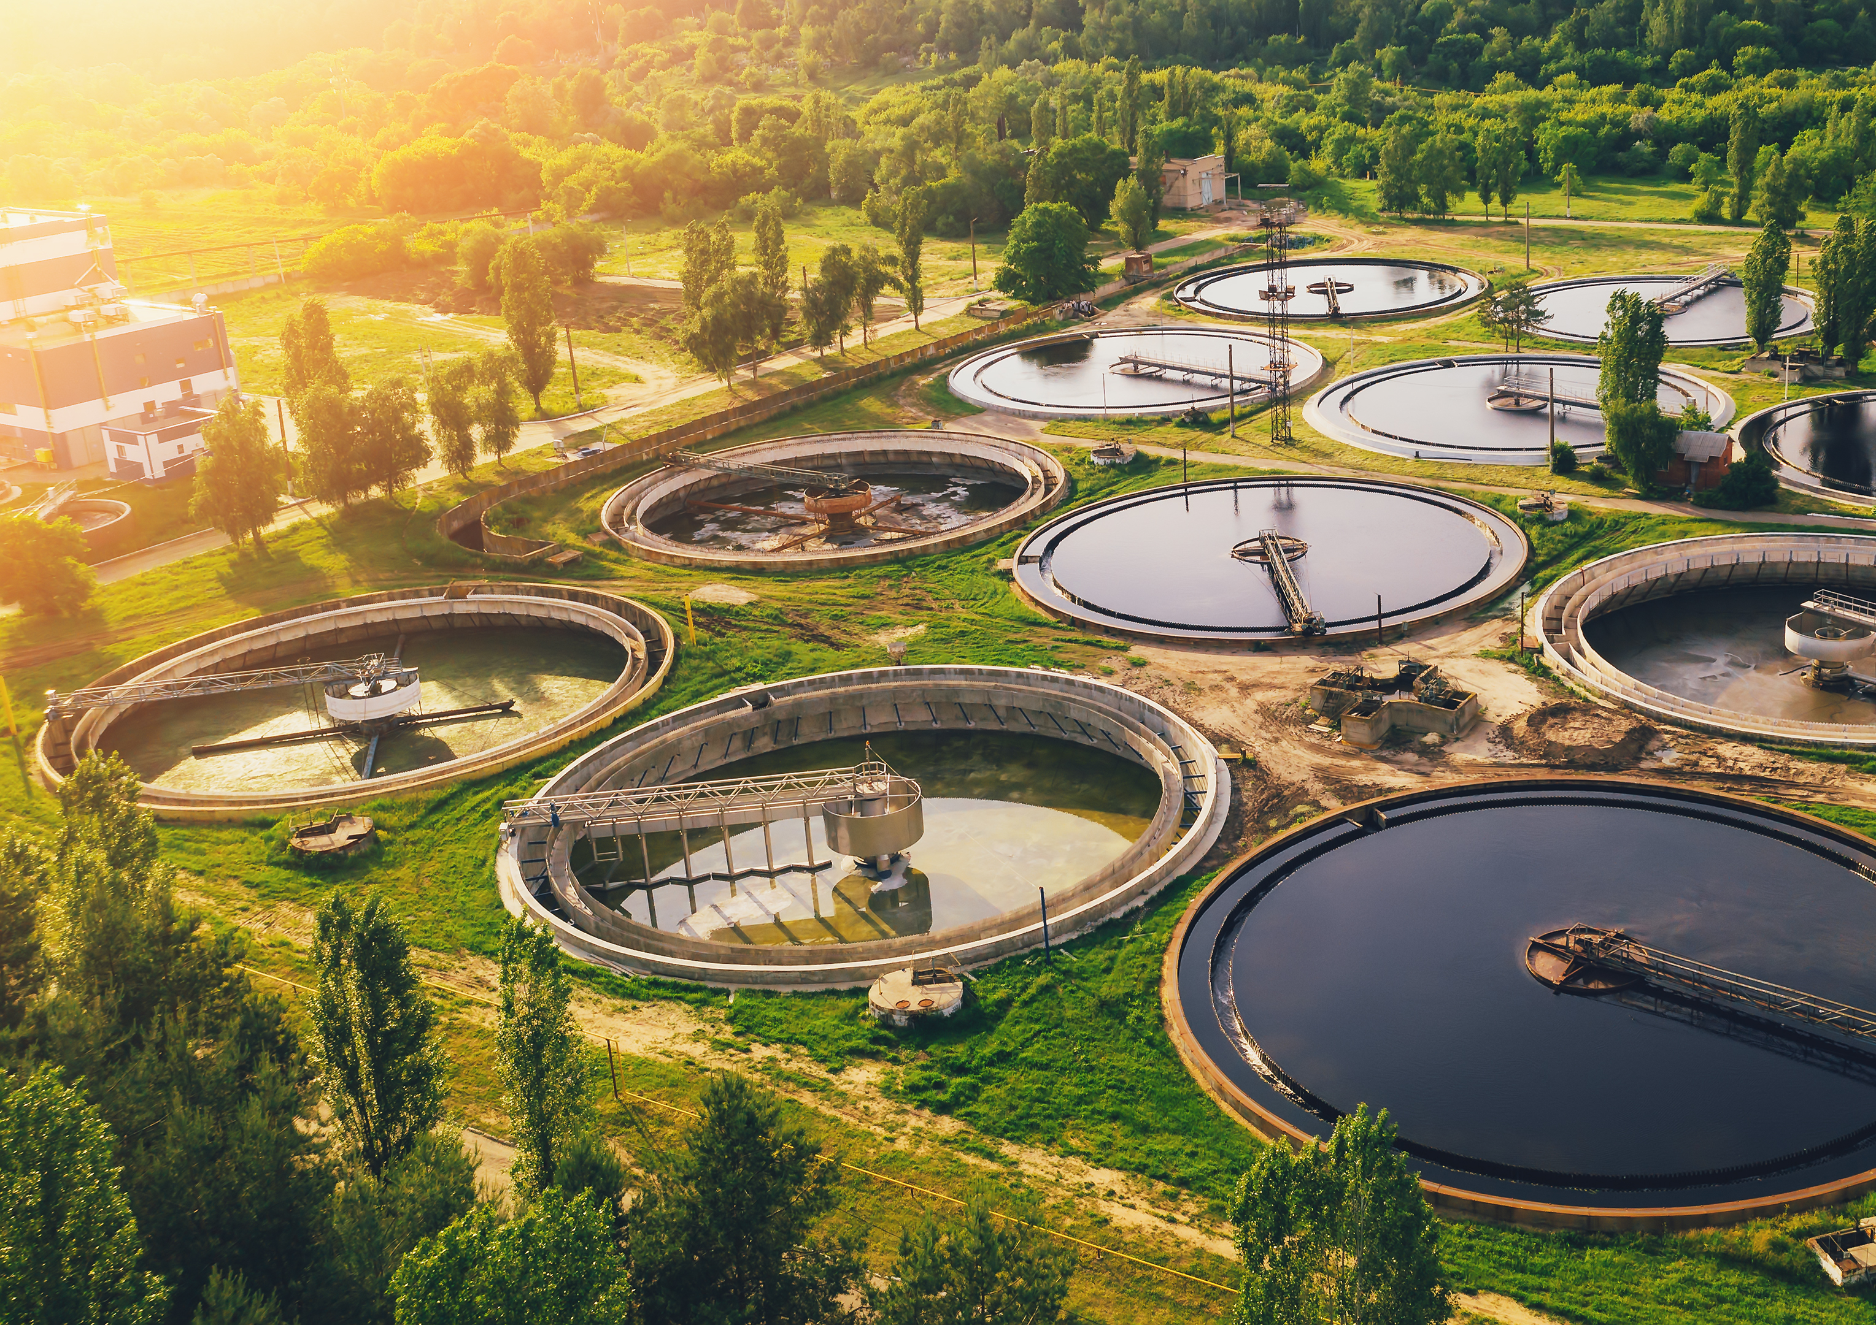
Careers connected to habitats:
Knowledge Organiser: Living things and their habitat - Conservation
Careers connected to the human body:
doctor, nurse, massage therapist, personal trainer, theatre technician
Why environments change
How environments change?
Lesson Sequence
NATURAL CHANGES – different seasons can change habitats. Greenhouse gases cause climate change and climate change has caused our planet to get a lot warmer over a very short period of time. This has caused more extreme weather events like hurricanes, floods and droughts. It has also caused the extinction of many living things.
HUMAN CHANGES – How humans live and what they do can impact habitats both negatively and positively.
Negative ways:
• Deforestation - cutting down trees for a range of reasons
• Littering – dropping rubbish or leaving large objects lying in the environment
• Pollution – introducing harmful substances into the environment.
• Air pollution from cars, e.g., carbon monoxide, and the burning of fossil fuels.
• Water pollution through industrial waste and farm fertilisers that can pollute rivers and streams.
• Rubbish—Plastic and household waste ends up on the streets, in the sea or in rubbish dumps, destroying habitats and wildlife.
Positive ways:
• Protecting endangered species via conservation projects
• Cleaning bodies of water
• Recycling
• Creating nature reserves
1. Describe ecosystems and how they are affected by changes in the seasons
Seasonal change
2. Understand human impact on the environment through deforestation
3. Explore air pollution
Nature reserves
Landslides
4. Understand water pollution
Flooding
Forest Fires
Water treatment Plant
5. Explore methods that can be used to conserve water
Oil Spills
6. Understand that humans can have a positive impact on nature
The water people use in their homes comes from nature and must be cleaned up to be returned to nature so it can be used again. This is an important part of our water cycle.
Developing Experts Copyright 2022 All Rights Reserved

Slide 2
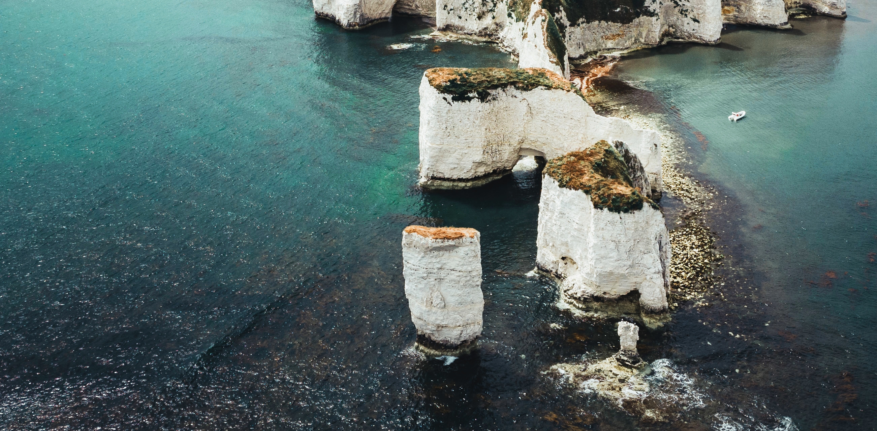
Knowledge Organiser: Living things and their habitat - Conservation
Careers connected to the human body:
doctor, nurse, massage therapist, personal trainer, theatre technician
Before and After Test
Which of these is a man-made disaster?
before
after
What has become more frequent thanks to the increase of greenhouse gases?
Which is these is a natural disaster?
before
after
oil spill
flooding
 | before | after
Forest fires
Landslide
Flooding
Recycling
Deforestation
Oil Spills
forest fire
water pollution
building development
rubbish
recycling
volcano
deforestation
Write the word of each living thing in the Venn diagram to show where they belong.
before
after
Nature reserve
World Heritage Site
Flooding
Landslide
Forest fire
Oil spill
Natural disaster
Man-made disaster
Developing Experts Copyright 2022 All Rights Reserved

Slide 3
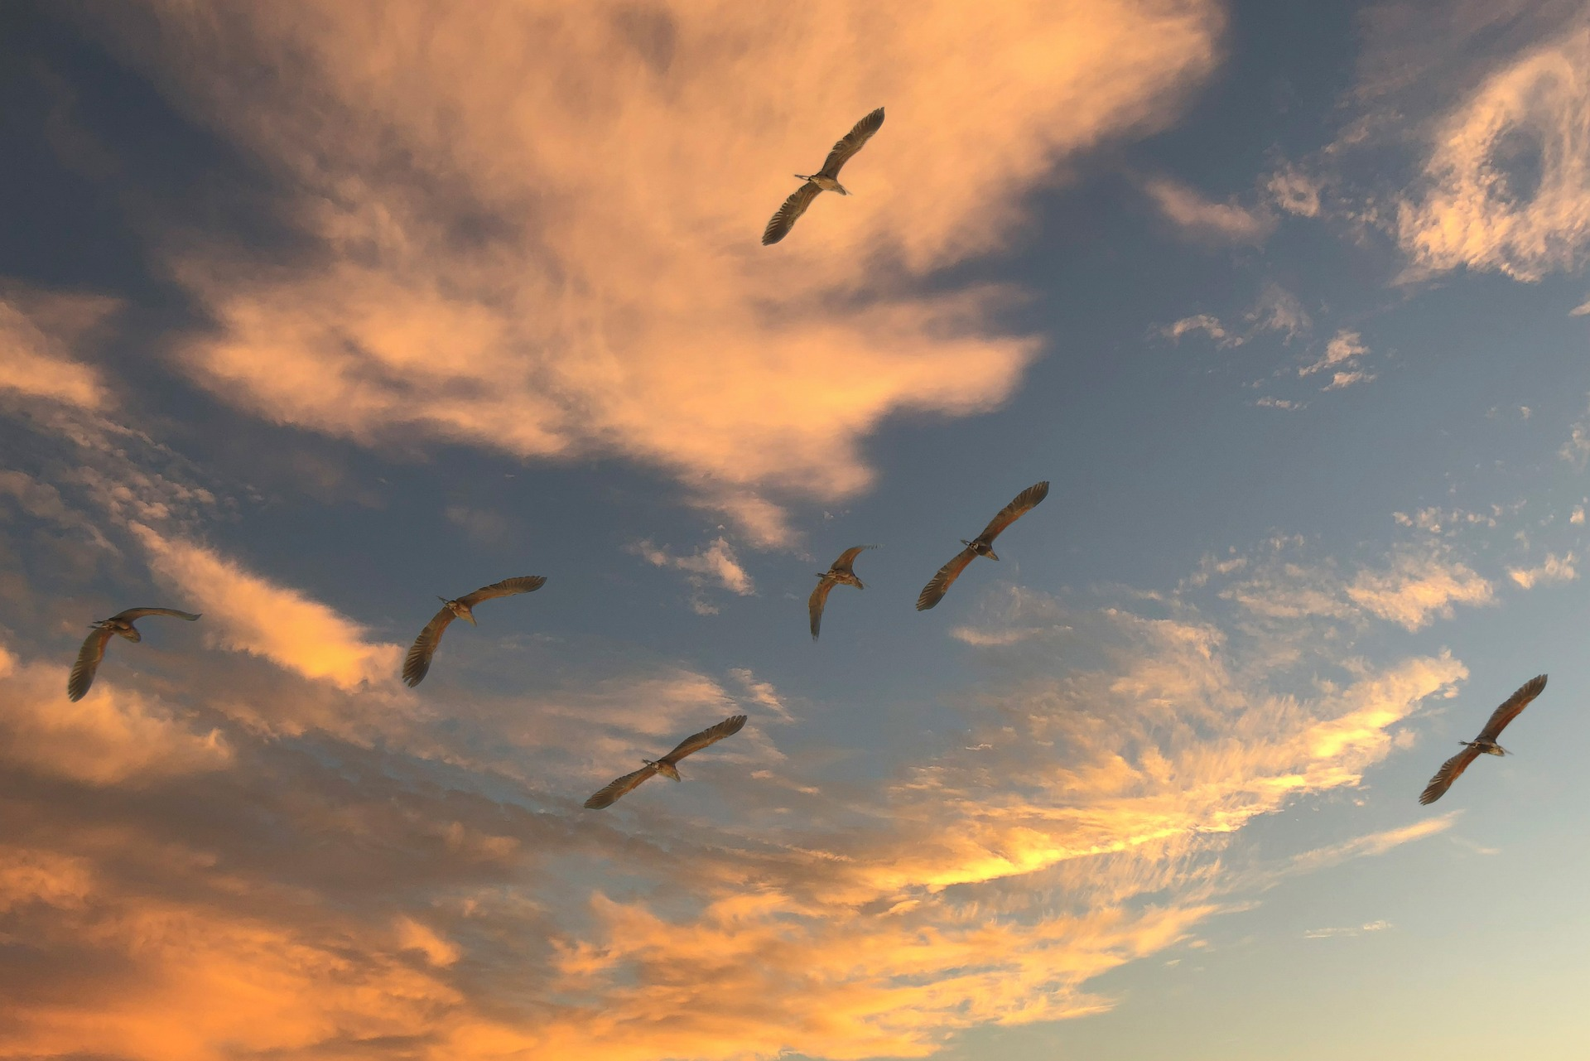
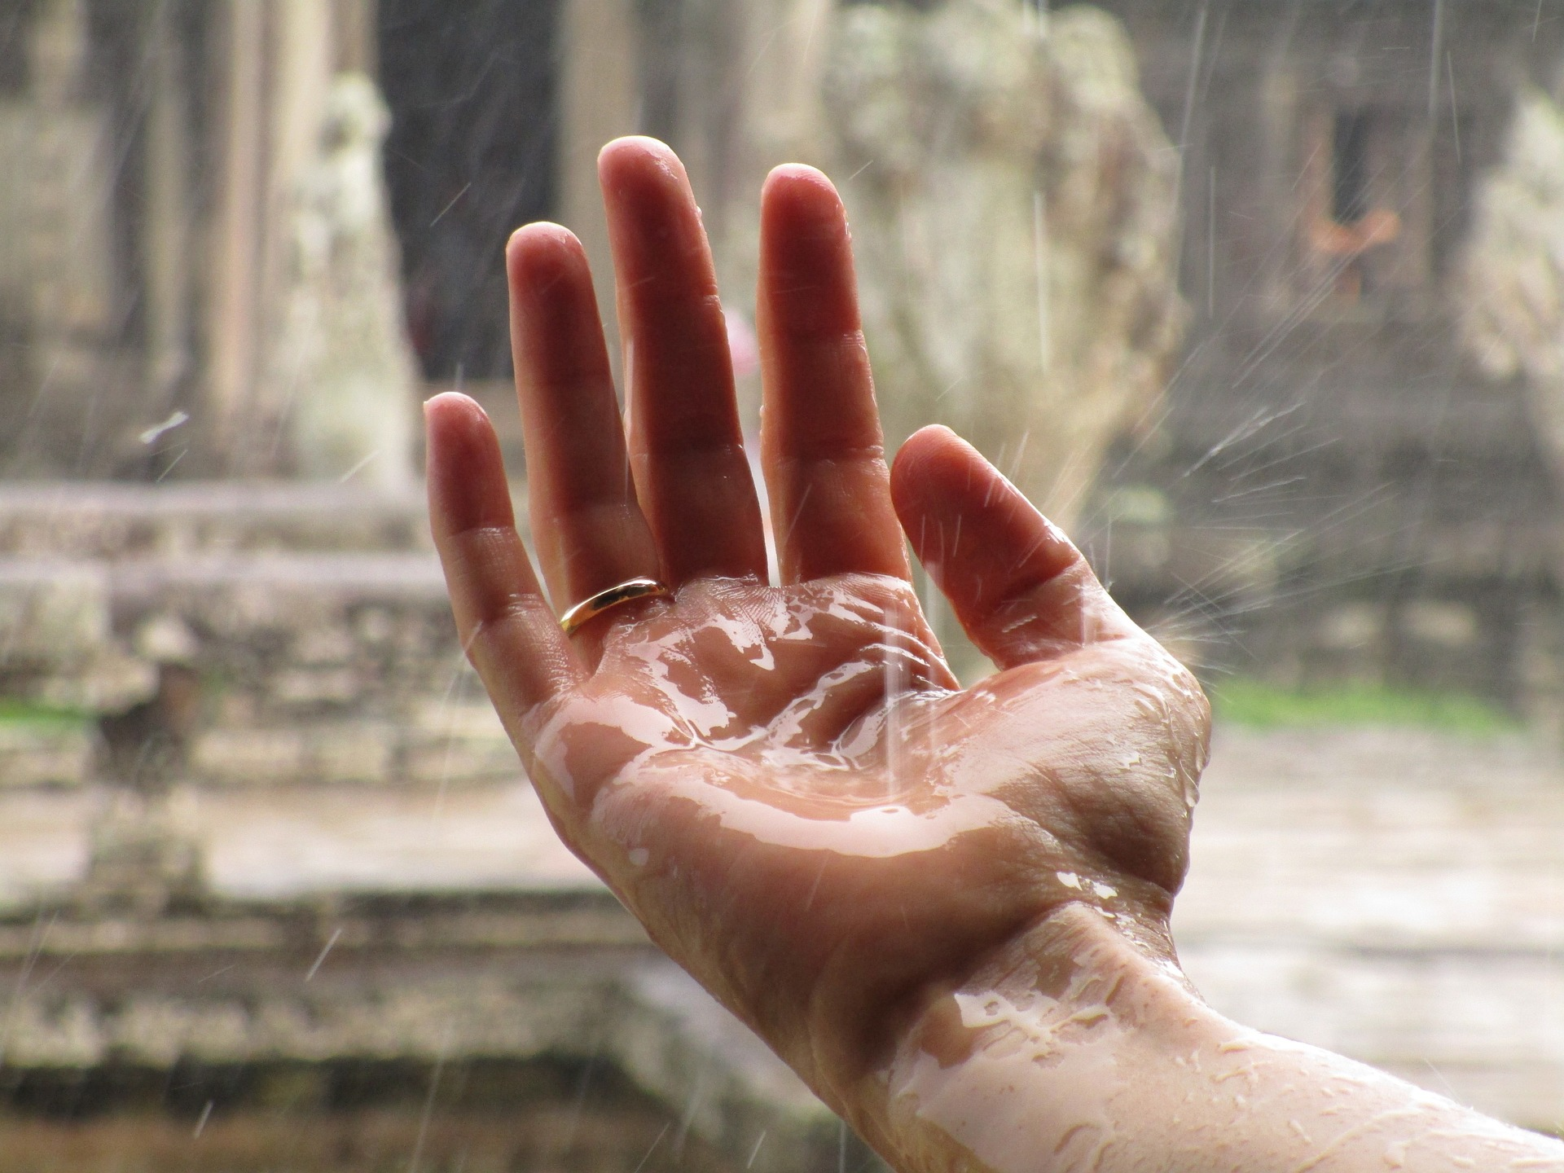
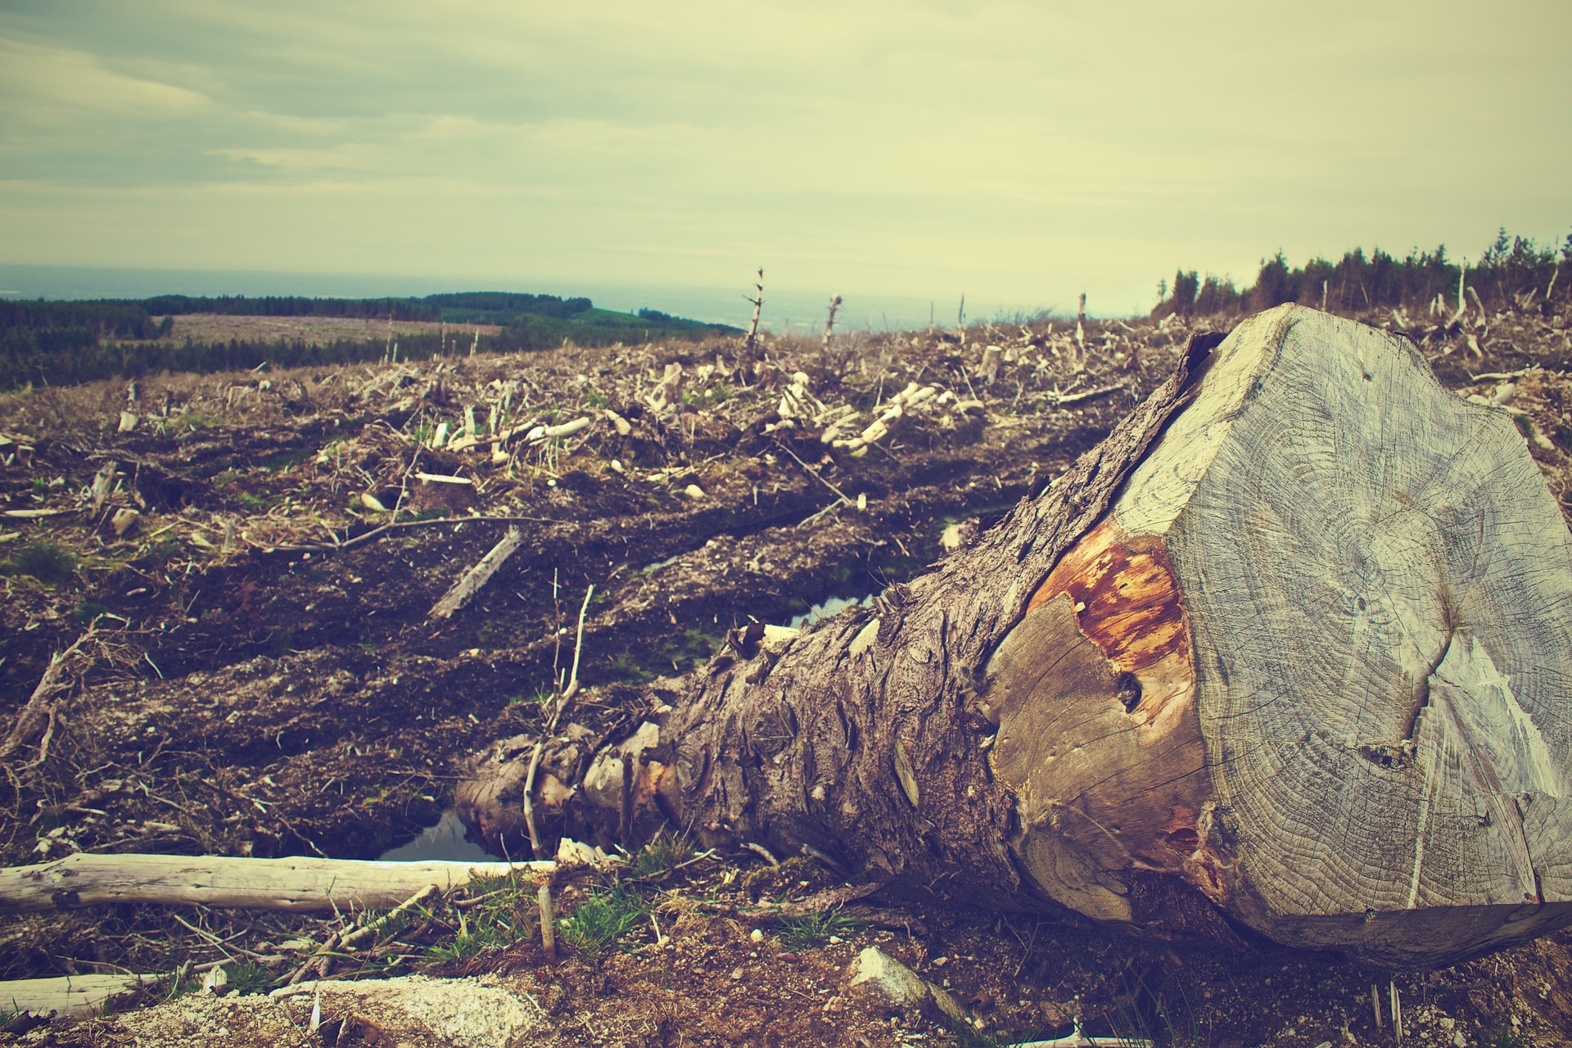
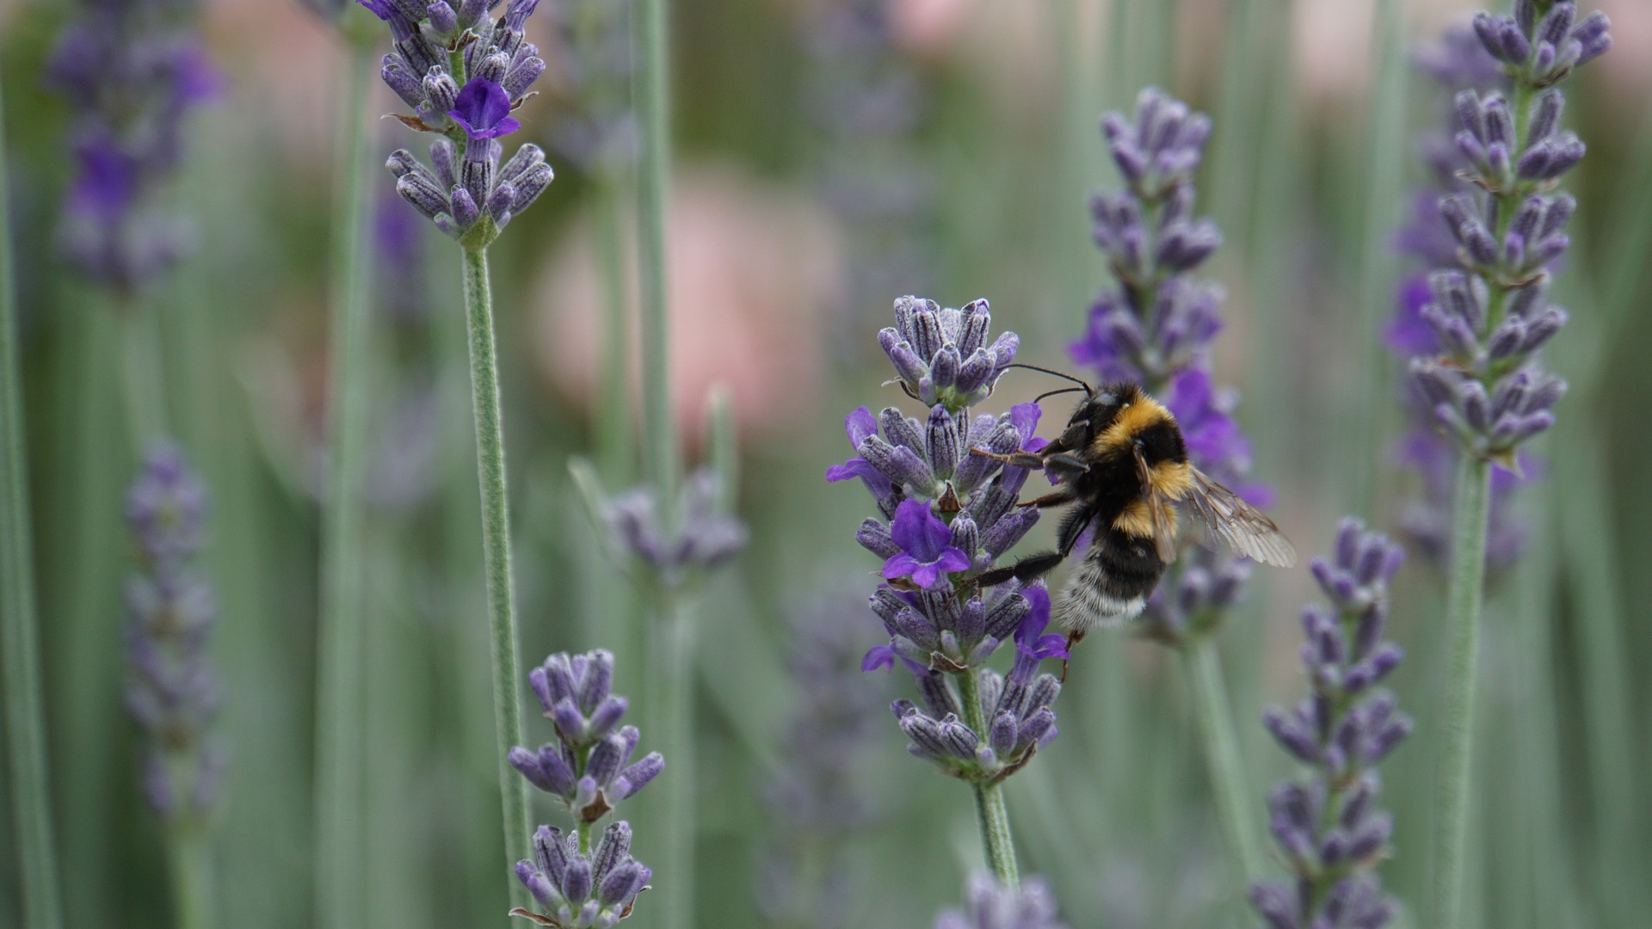
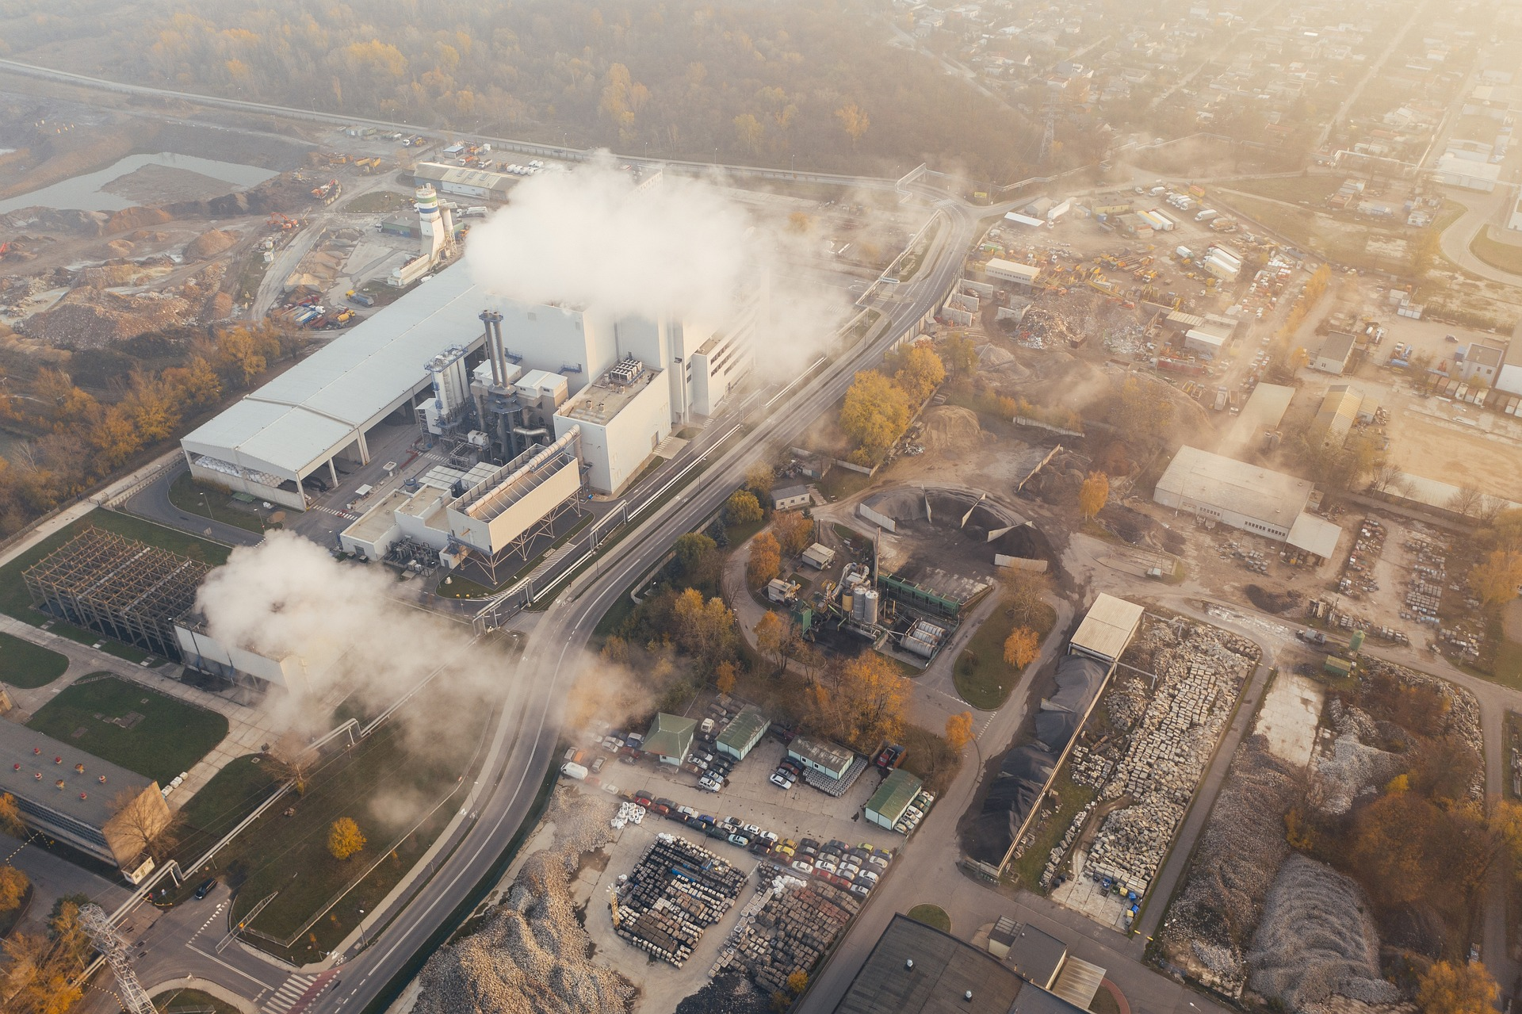
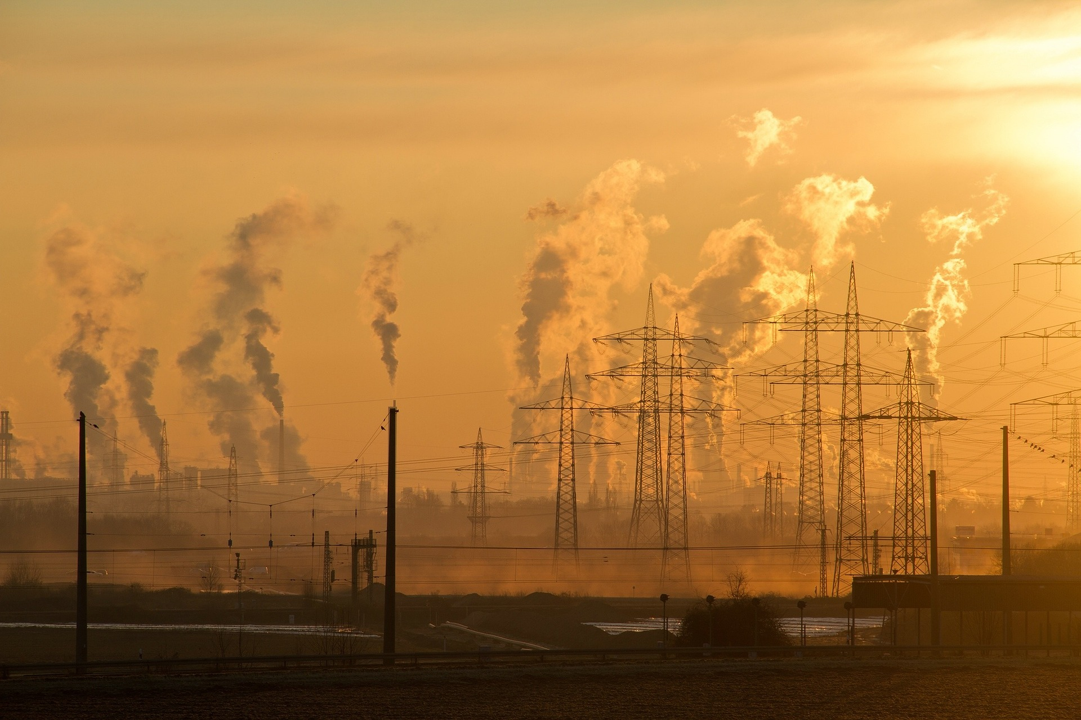
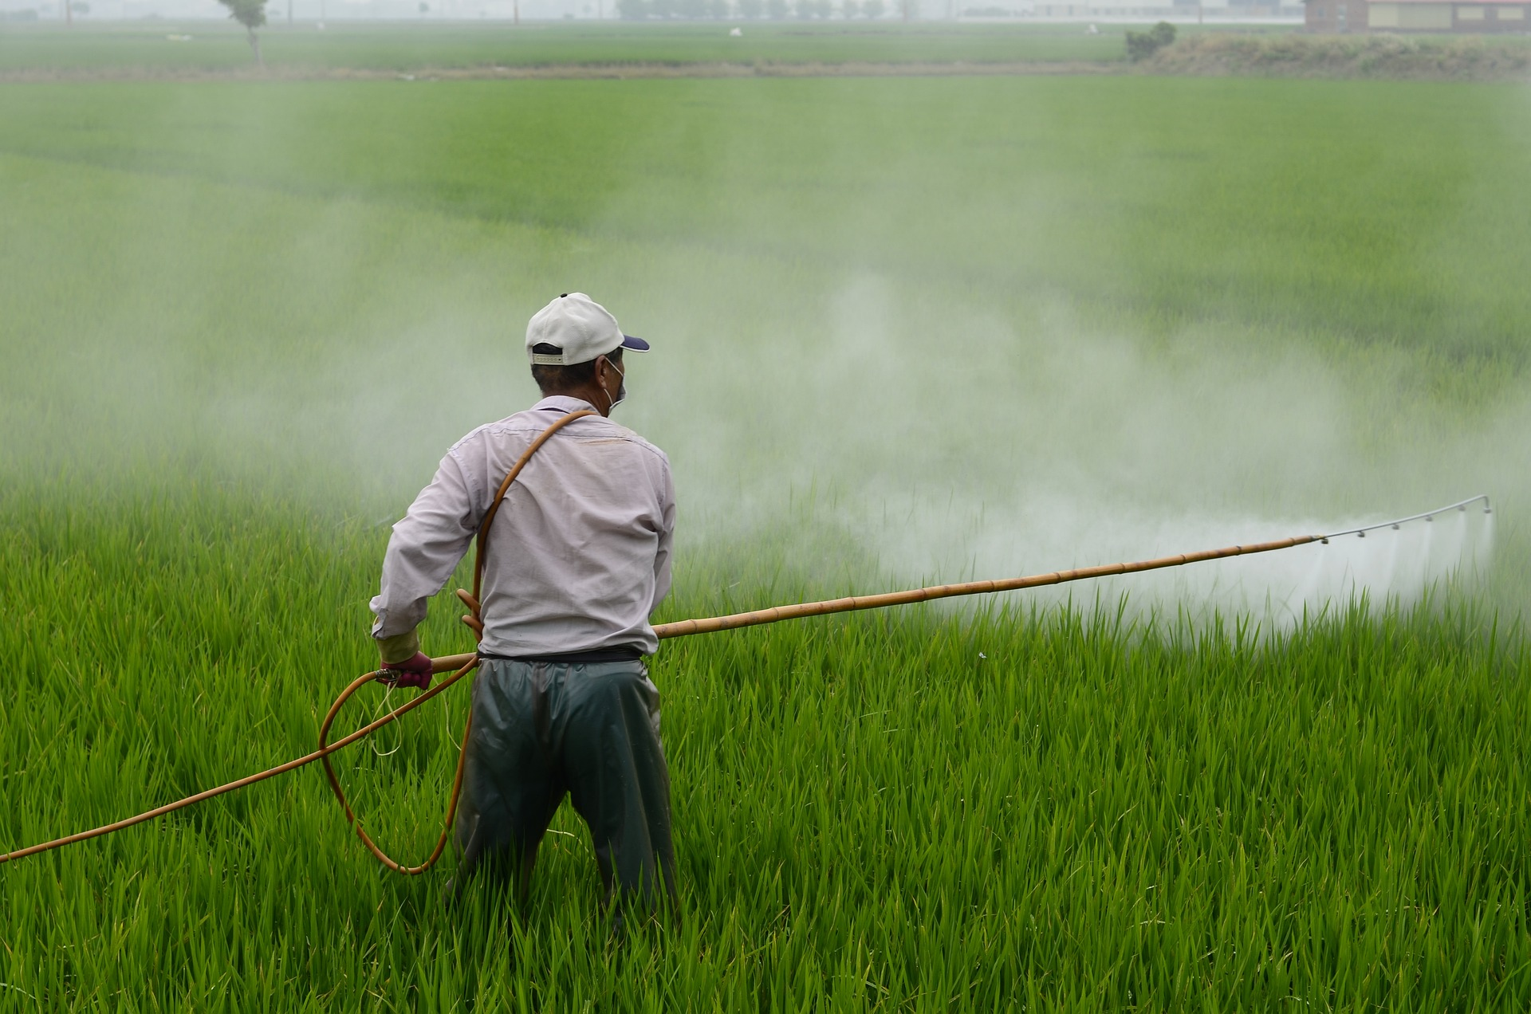
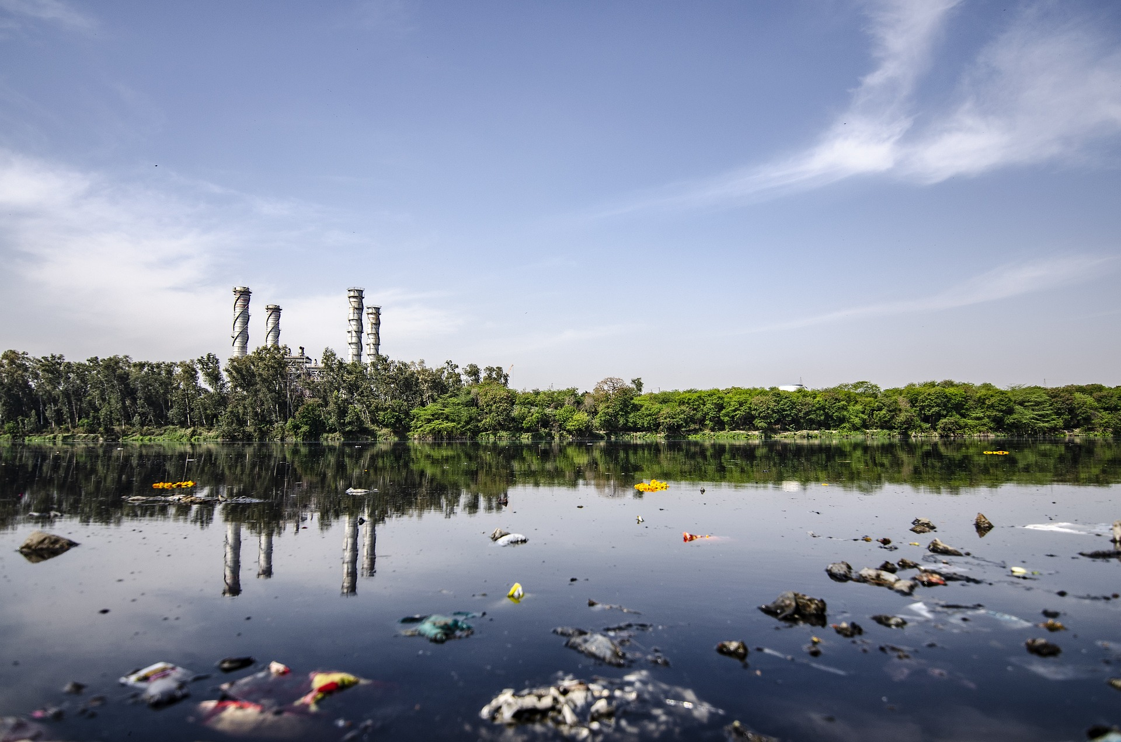
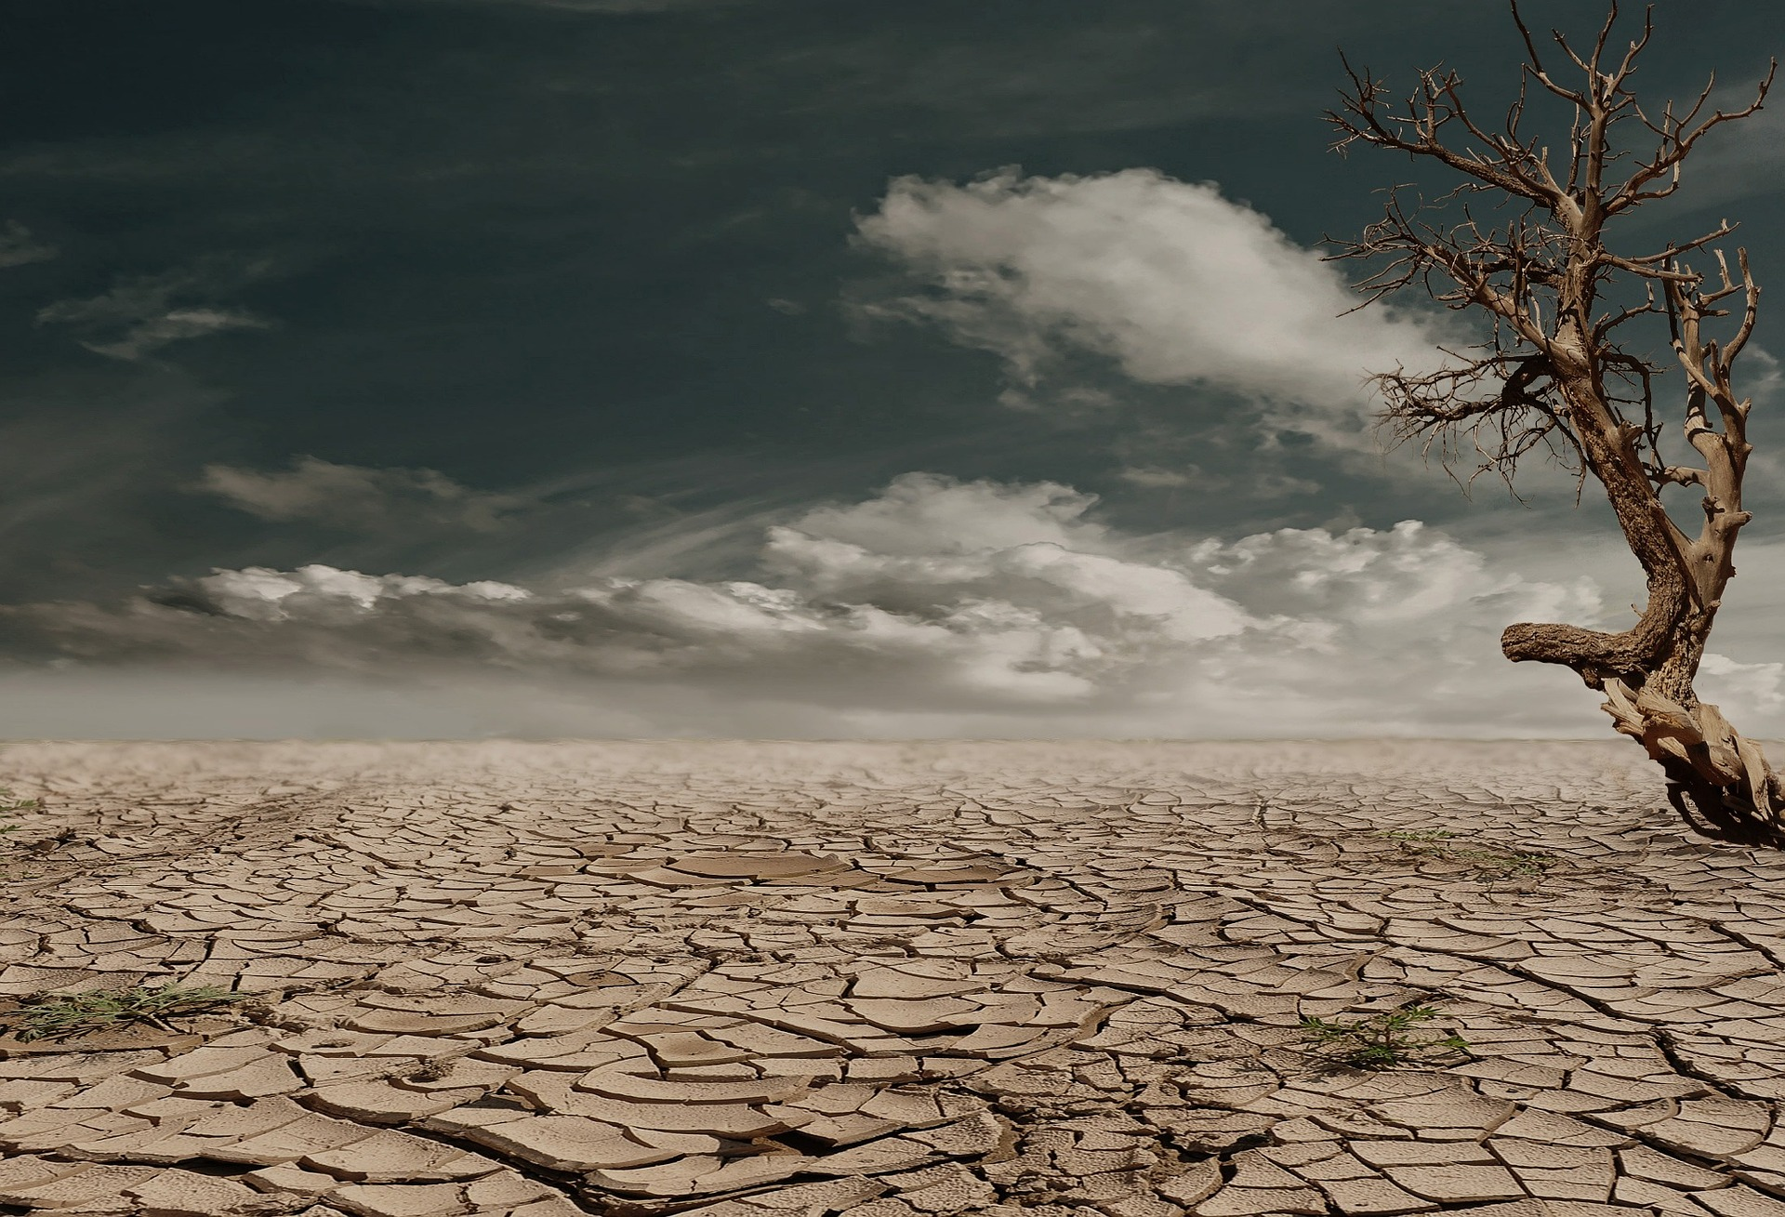
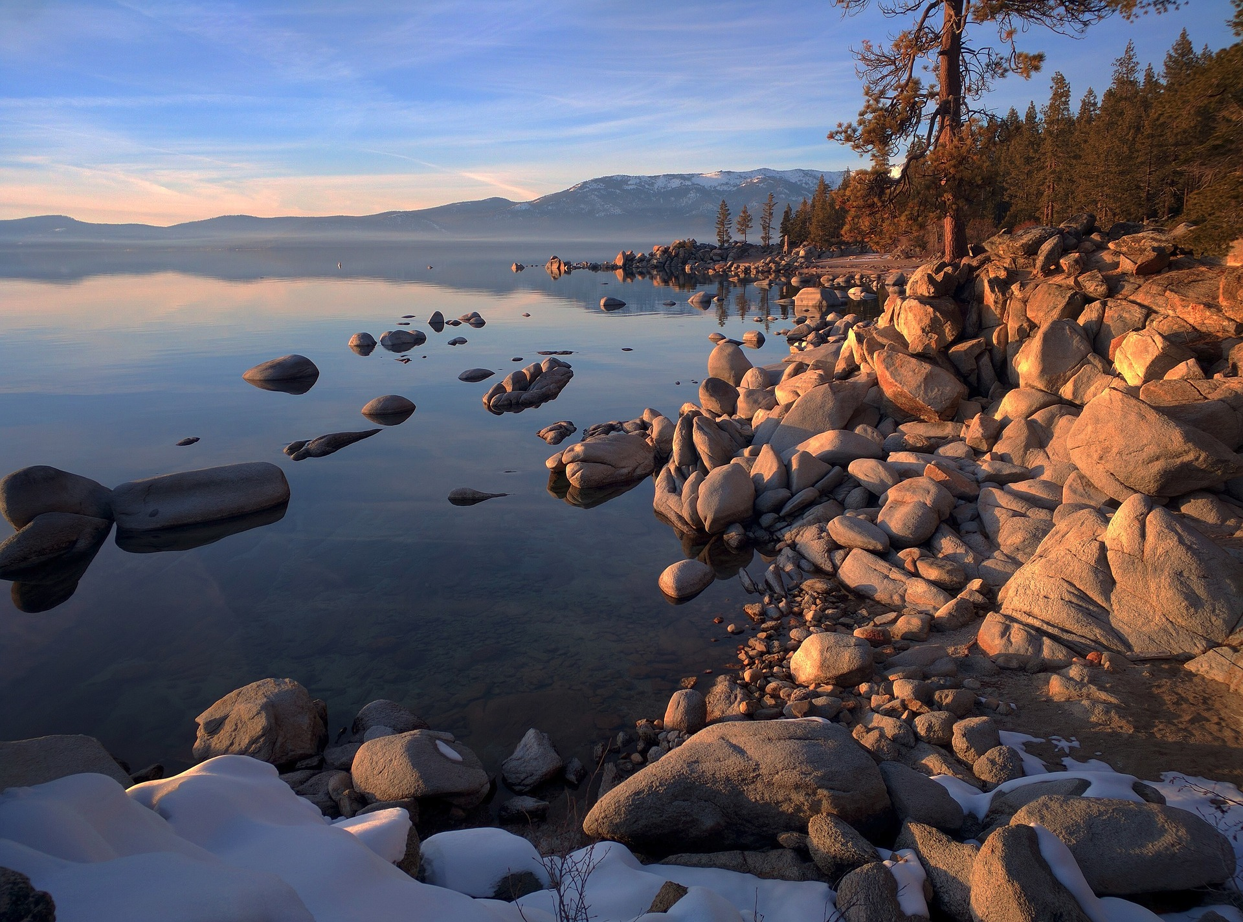
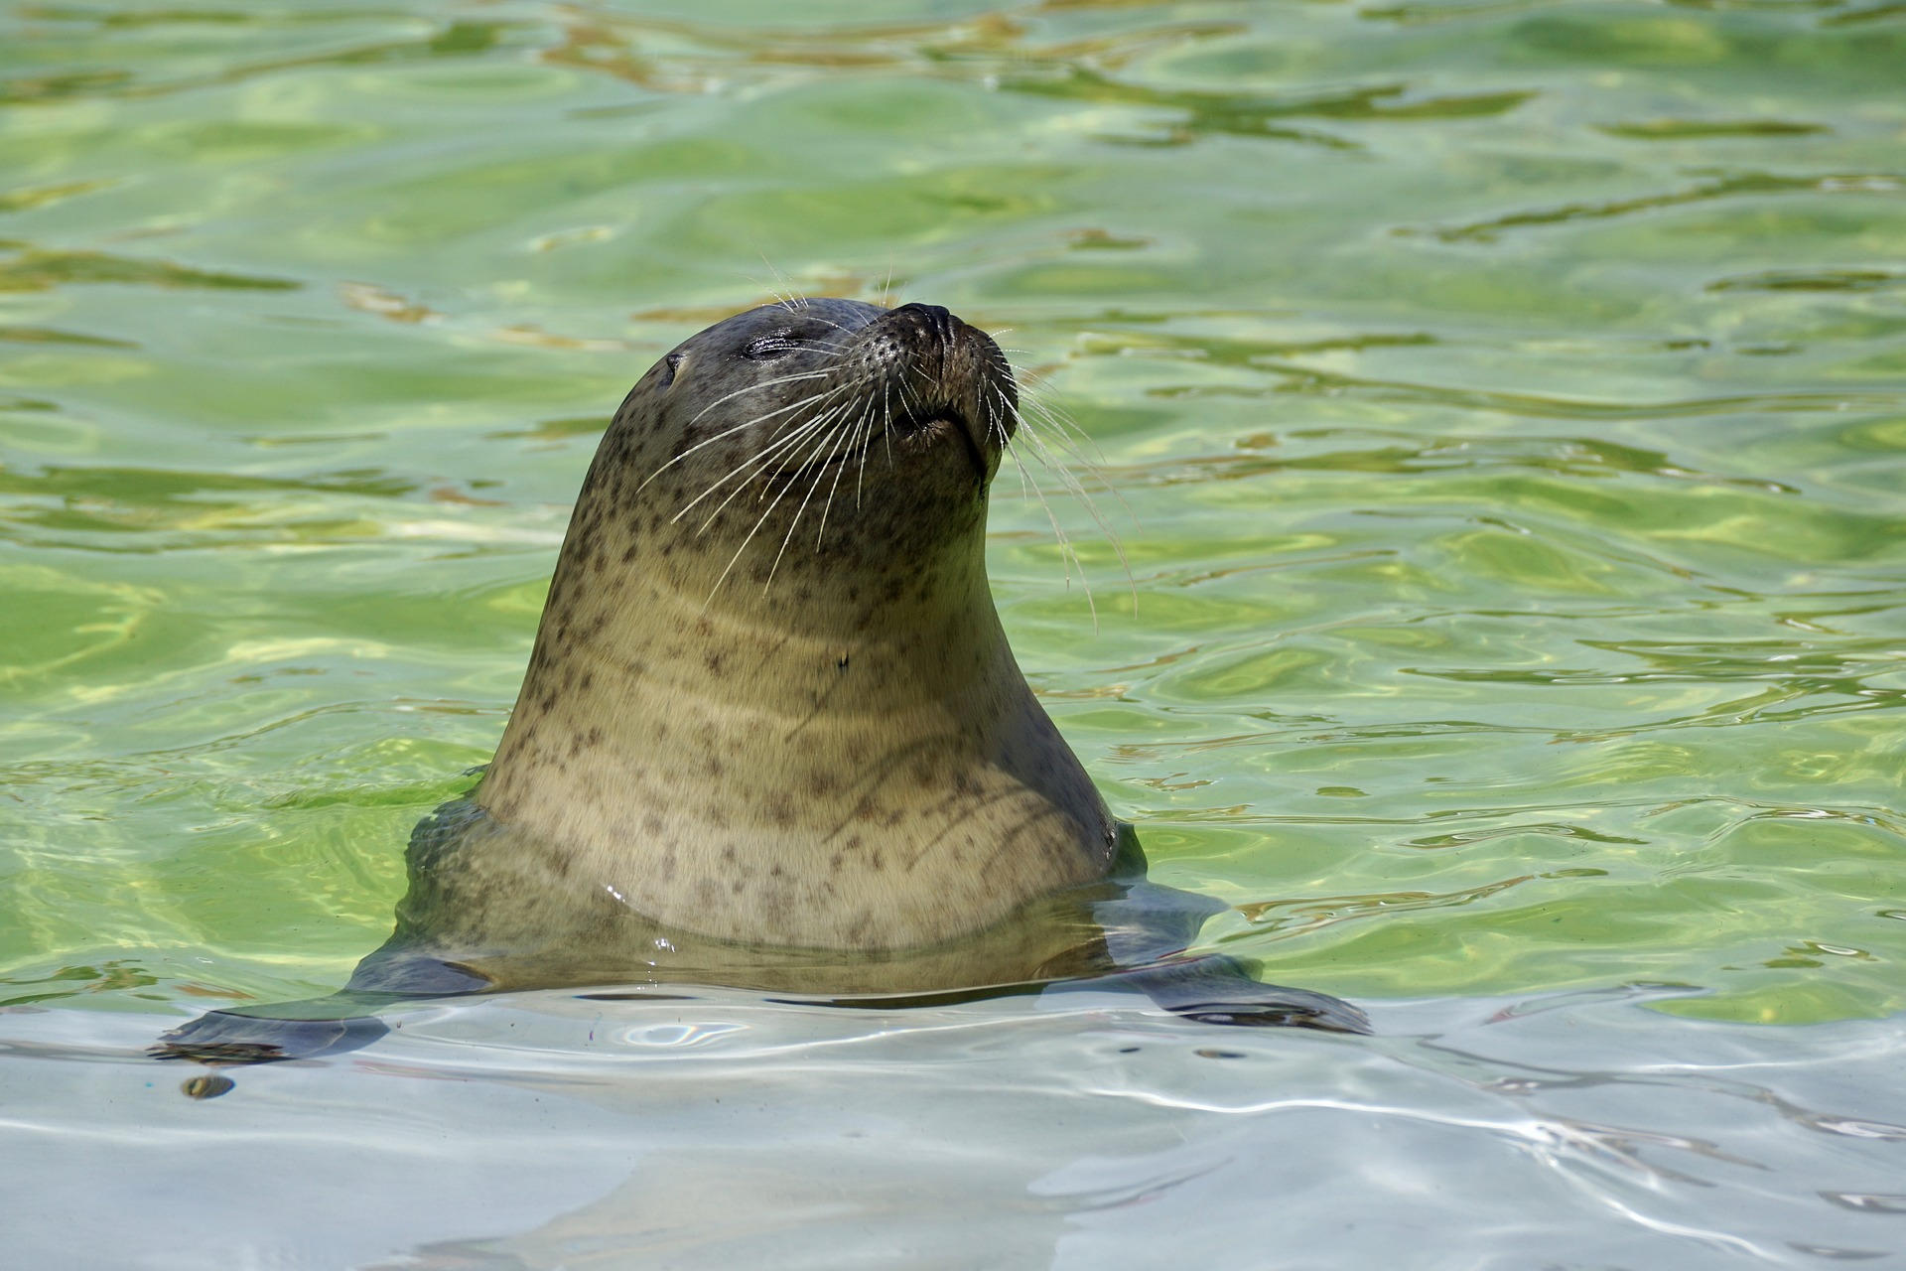
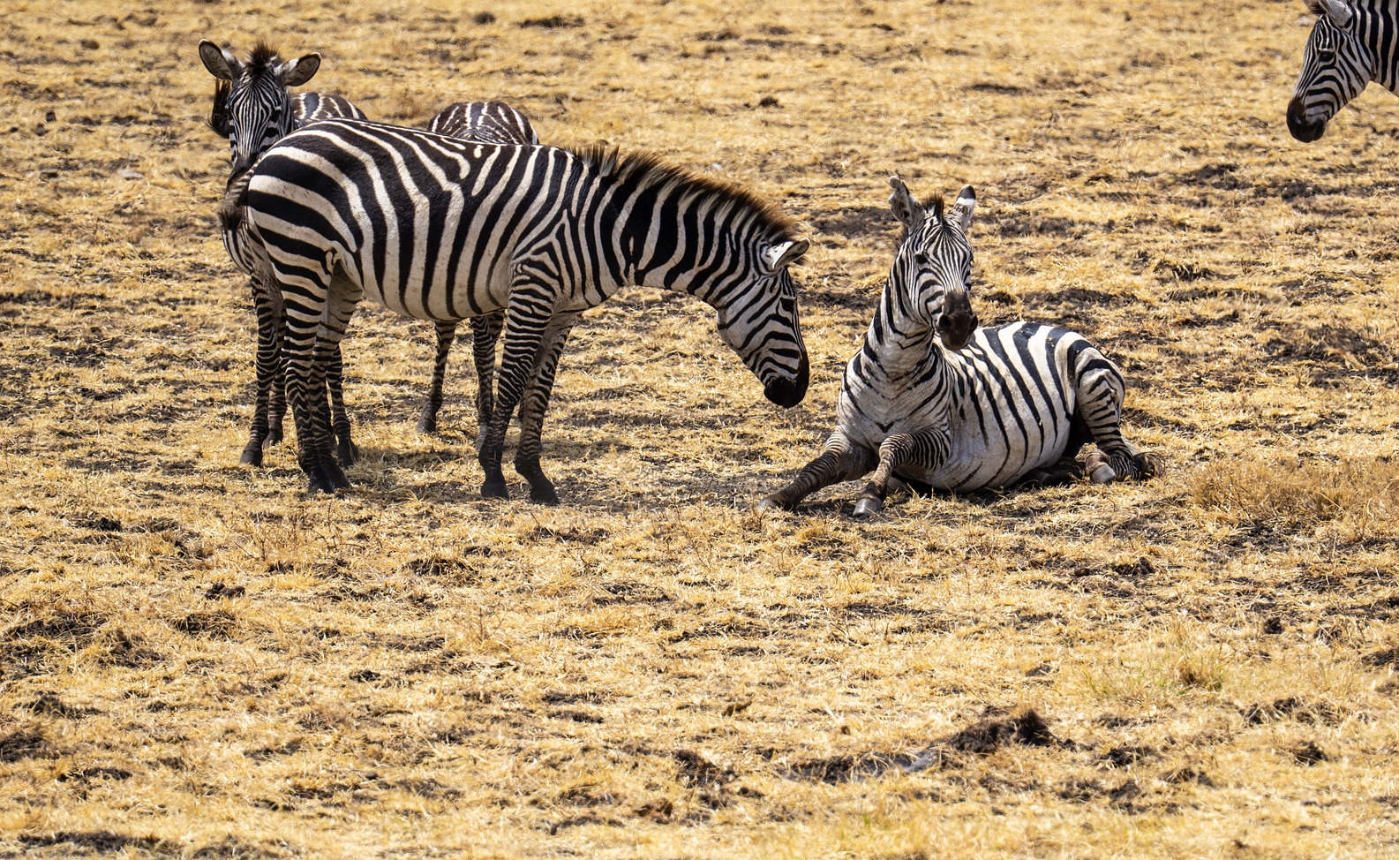
Careers connected to the human body:
doctor, nurse, massage therapist, personal trainer, theatre technician
Unit Rocket Words: Year 4 - Living things and their habitats – conservation
Rocket Words
 | migrate | to move from one area to another
 | monsoon | rainy season
 | deforestation | the cutting down of forests, including rainforests
 | biodiversity | the variety of living things
 | emissions | the production or discharge of something, especially gas or radiation
 | pollution | harmful or poisonous substances
 | pesticide | a chemical substance used to kill insects that harm plants and crops
 | contaminate | to make something impure by adding a poisonous or polluting substance
 | drought | a long period of time where there is a shortage of water
 | freshwater | water that does not contain salt
 | marine sanctuaries | ocean areas that protect the wildlife from harm
 | conservation areas | areas on land or sea that protect the wildlife from harm
Developing Experts Copyright 2022 All Rights Reserved

