Slide 1



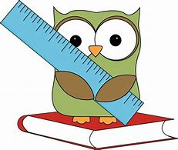

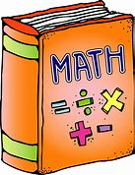
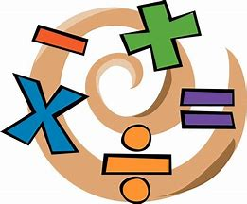
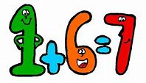


Year 4 to Year 5 Maths Learning Journey
Year 5
describe movements between positions as translations of a given unit to the left/right and up/down
interpret and present discrete and continuous data using appropriate graphical methods, including bar charts and time graphs
Statistics
solve comparison, sum and difference problems using information presented in bar charts, pictograms, tables and other graphs.
plot specified points and draw sides to complete a given polygon
Position & Direction
complete a simple symmetric figure with respect to a specific line of symmetry.
identify lines of symmetry in 2-D shapes presented in different orientations
identify acute and obtuse angles and compare and order angles up to 2 right angles by size
describe positions on a 2-D grid as coordinates in the first quadrant
measure and calculate the perimeter of a rectilinear figure (including squares) in centimetres and metres
estimate, compare and calculate different measures, including money in pounds and pence
Properties of Shape
read, write and convert time between analogue and digital 12 and 24-hour clocks
compare and classify geometric shapes, including quadrilaterals and triangles
find the area of rectilinear shapes by counting squares
Measurement
solve simple measure and money problems involving fractions and decimals to 2 decimal places
compare numbers with the same number of decimal places up to 2 decimal places
round decimals with 1 decimal place to the nearest whole number
convert between different units of measure
find the effect of dividing a one- or two-digit number by 10 and 100
recognise and show, using diagrams, families of common equivalent fractions
Fractions (including decimals)
recognise and write decimal equivalents to ¼; ½; ¾
count up and down in hundredths
solve problems involving increasingly harder fractions to calculate quantities
add and subtract fractions with the same denominator
recognise and write decimal equivalents of any number of tenths or hundredths
solve problems involving multiplying and adding
multiply two-digit and three-digit numbers by a one-digit number using formal written layout
recognise and use factor pairs and commutativity in mental calculations
Multiplication & Division
use place value, known and derived facts to multiply and divide mentally,
recall multiplication and division facts for multiplication tables up to 12 × 12
add and subtract numbers with up to 4 digits using the formal written methods of columnar addition and subtraction where appropriate
Addition & Subtraction
solve addition and subtraction two-step problems in contexts, deciding which operations and methods to use and why
estimate and use inverse operations to check answers to a calculation
recognise the place value of each digit in a four-digit number (1,000s, 100s, 10s and 1s)
Number & Place Value
order and compare numbers beyond 1,000
round any number to the nearest 10, 100 or 1,000
read Roman numerals to 100 (I to C)
Year 4
count backwards through 0 to include negative numbers
find 1,000 more or less than a given number
count in multiples of 6, 7, 9, 25 and 1,000

