Slide 1
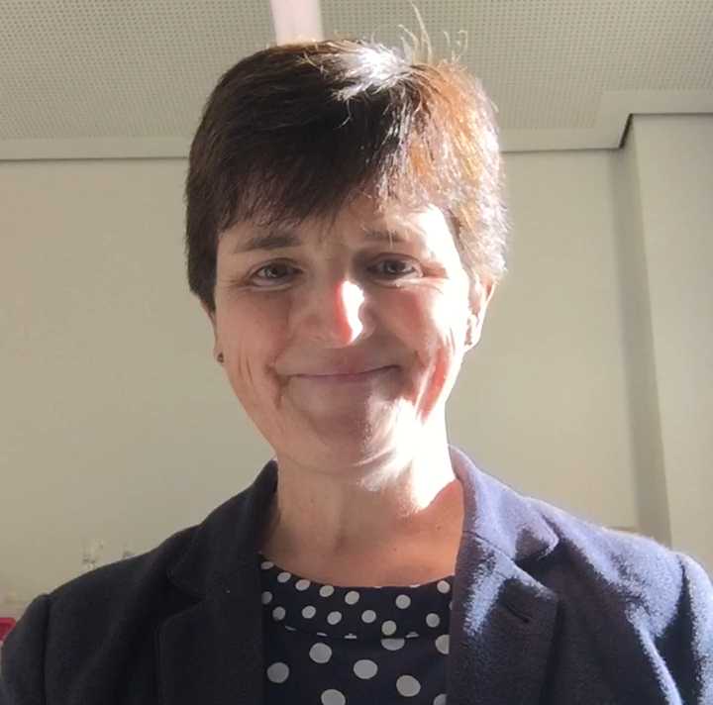

Welcome to our
Virtual Open Day
Autumn 2020
HOLY TRINITY C of E PRIMARY SCHOOL

Slide 2

Welcome
➲ Sharing the vision
➲ All about Holy Trinity Primary School
➲ Any questions? Please email headteacher@holytrinity.merton.sch.uk
➲ Virtual Tour of the school
HOLY TRINITY C of E PRIMARY SCHOOL

Slide 3
Our Vision
We want our pupils to grow in confidence, independence, resilience and knowledge, so that all achieve their full potential and develop a life-long love of learning and of the world around us.
We work together with families, community and church to model positive relationships, supporting each other and acknowledging that we are stronger when we work together.
We are growing together as children of God, strengthening our faith, secure in the knowledge we are unique, loved and cherished.
GROWING TOGETHER AS CHILDREN OF GOD

Slide 4
Growing together rules

Slide 5
About Holy Trinity Primary School
✓Church of England School – have the benefit of working with both Merton and Southwark Diocese
✓2 form entry school
✓Close links with Holy Trinity Church
✓Close links with other local schools

Slide 6
About Holy Trinity Primary School
✓Graded Outstanding by Ofsted (2013)
✓Graded Outstanding by SIAMS (2018)
✓Good outcomes at the end of each Key Stage

Slide 7
About Holy Trinity Primary School
✓Parents actively involved – helping on trips/in class, and organising many fundraising events
✓Strong Governing Body who act as critical friends

Slide 8
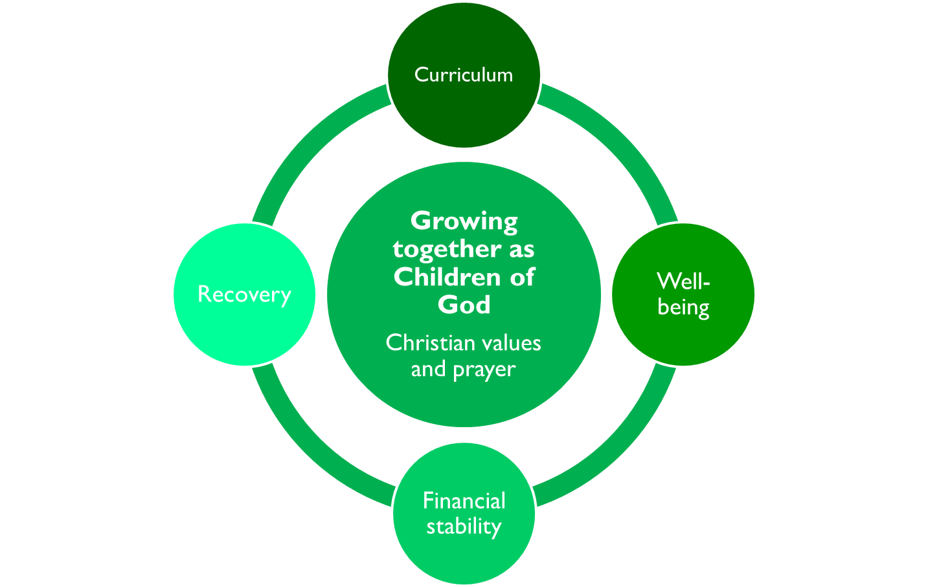

Key Priorities
2020-2021

Slide 9
Key Priorities 2020-2021
✓We will hold unswervingly to our Christian values and will be a praying community.
✓We will ensure that all children recover from the impact of the COVID-19 lockdown so that all are appropriately challenged and supported to achieve their full potential, through quality first teaching, and specific interventions.

Slide 10

✓ We will continue to develop the curriculum (intent, implementation and impact) to ensure that the school always provides a rich, varied and exciting curriculum that inspires the children and develops progression of skills and a love of learning.

Slide 11
✓ We will prioritise mental health and well-being for children, families and staff.
✓We will explore ways of maximising our income and minimising our expenditure to develop financial stability.

Slide 12
Quotes from our recent Parent Survey
Teachers are kind and caring. There is great pastoral care and a sense of belonging through the Christian faith.
Strong values, supportive school environment, caring for each other, promotes respectful behaviour
The children feel safe, supported and respected by all.
Everyone is
welcomed and included.
The nurturing, caring and secure environment which is a great setting for children to thrive and flourish.
Very good teachers, lovely atmosphere within the community – my child loves to go to school every day!

Slide 13
Any questions?
Please email headteacher@holytrinity.merton.sch.uk

Slide 14
Virtual Tour

Slide 15
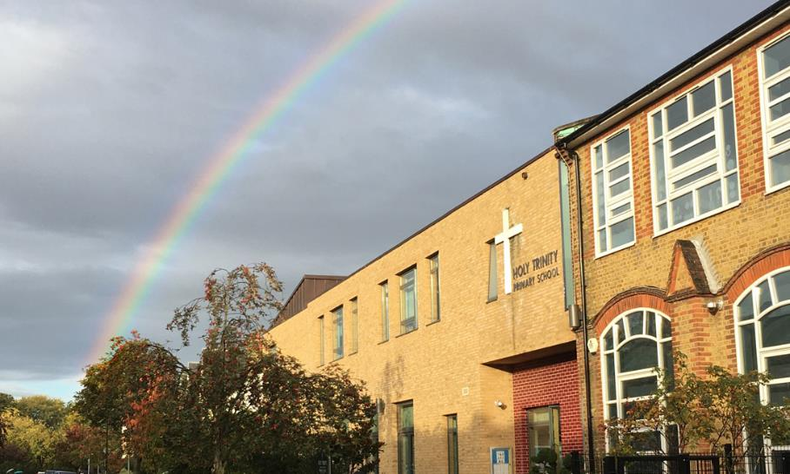

Slide 16
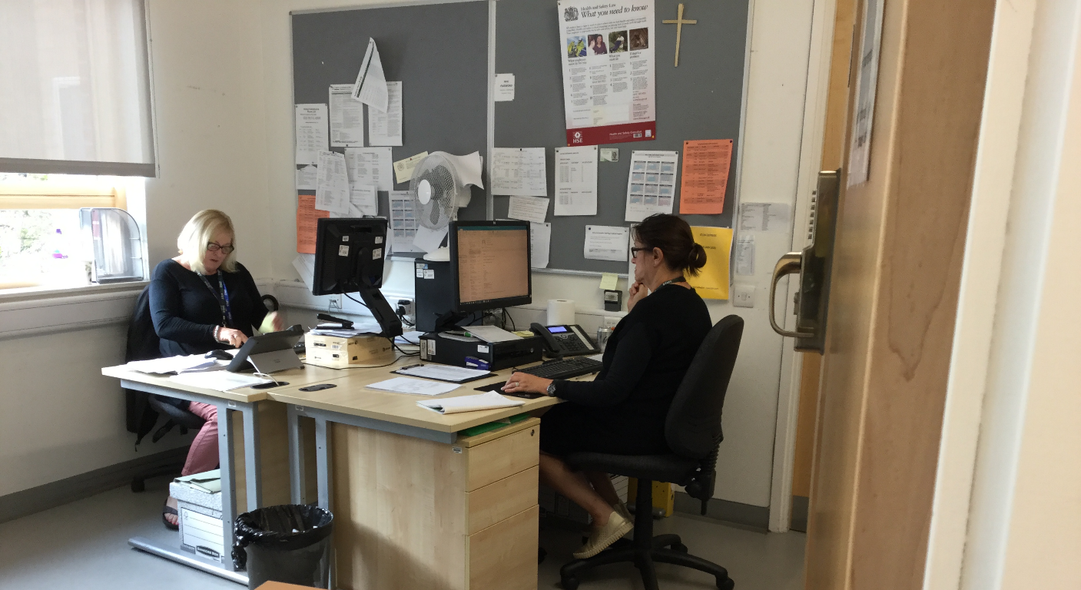

Slide 17
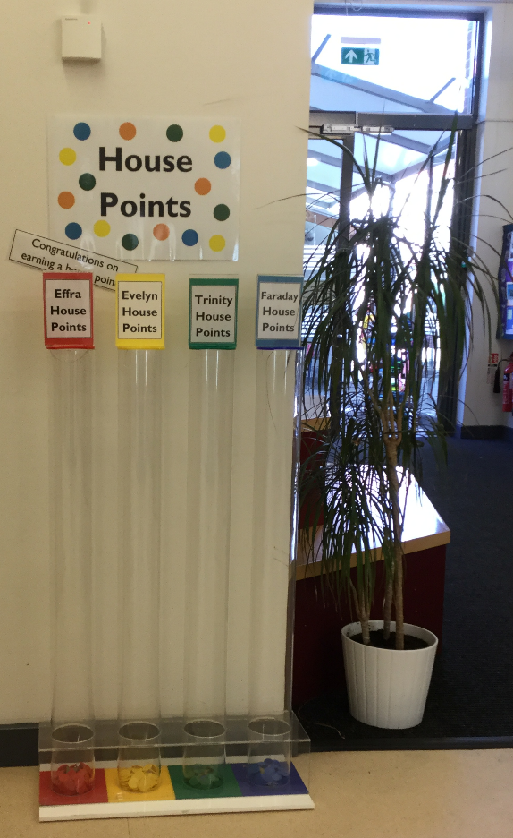
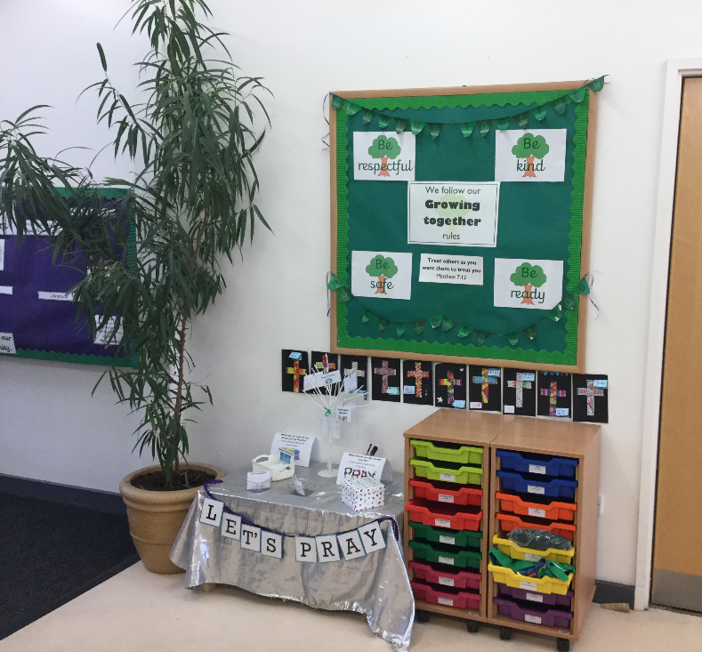

Slide 18
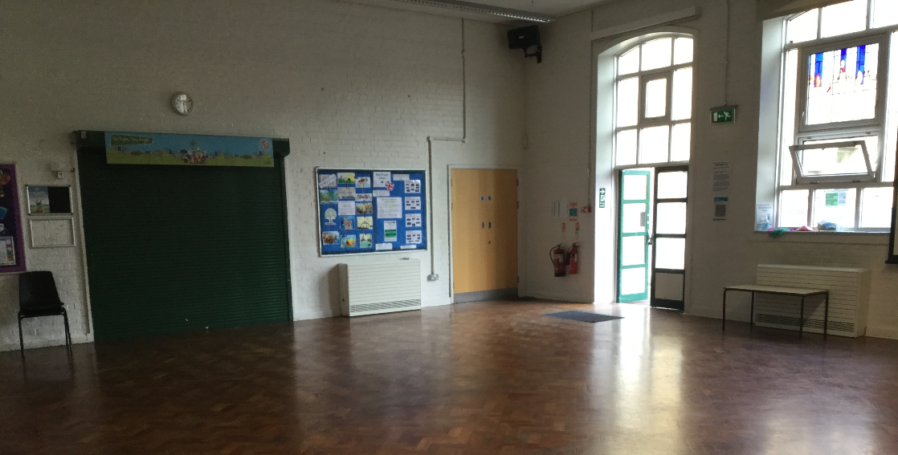
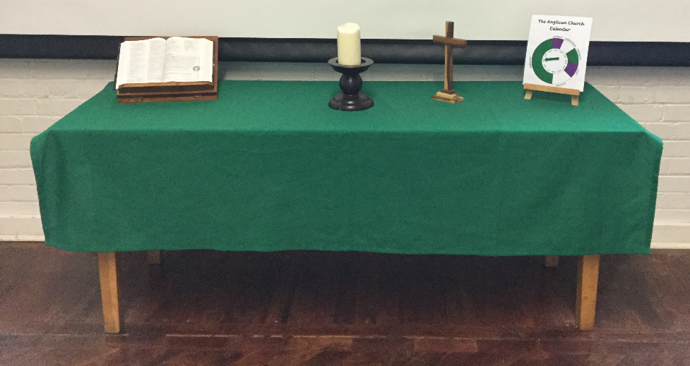

Slide 19
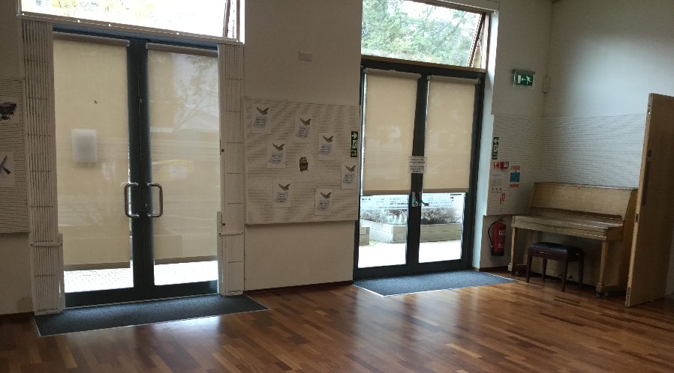
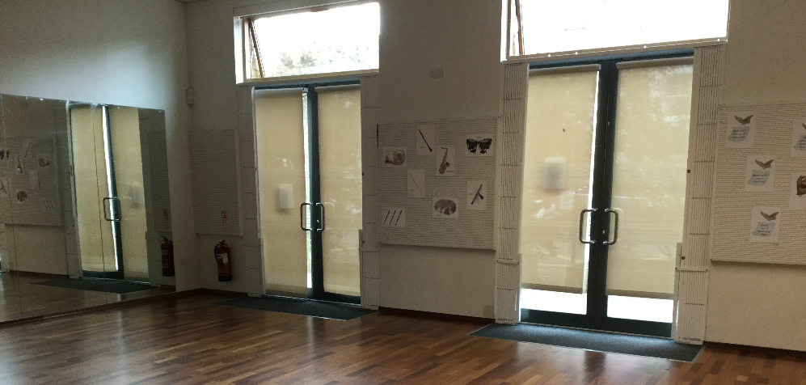

Slide 20
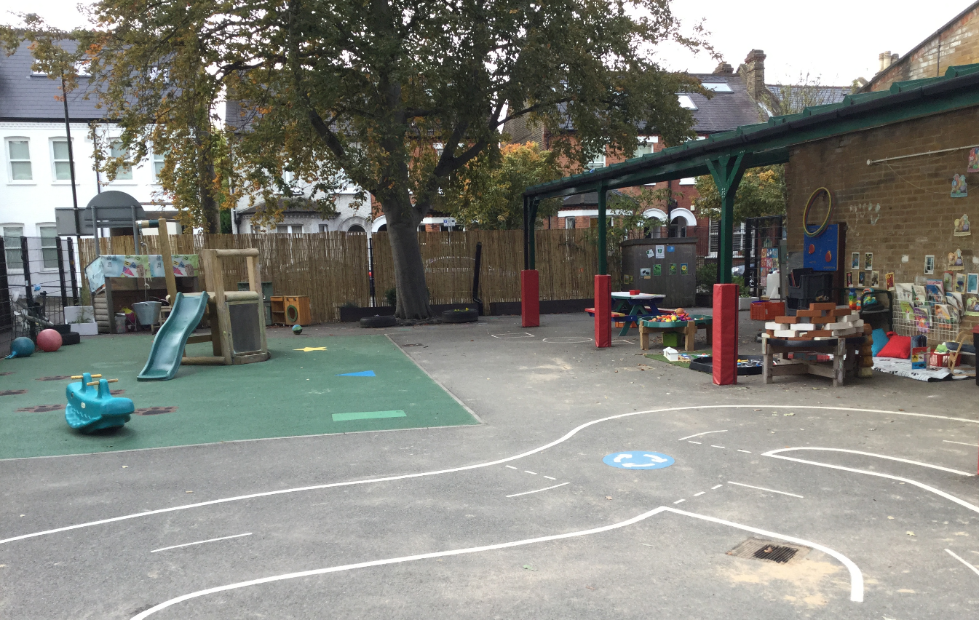

Slide 21
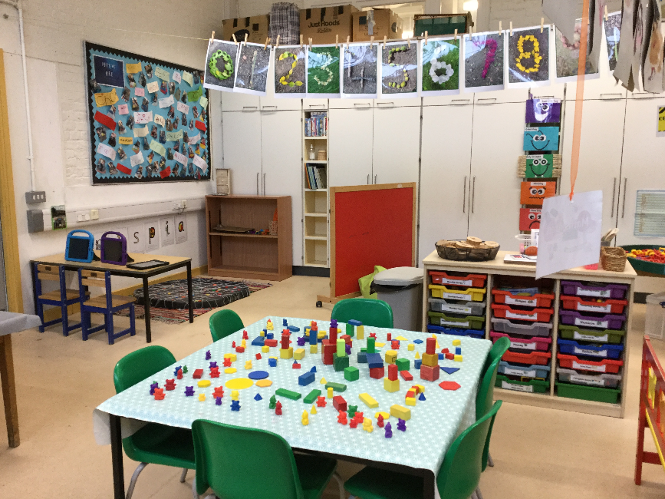
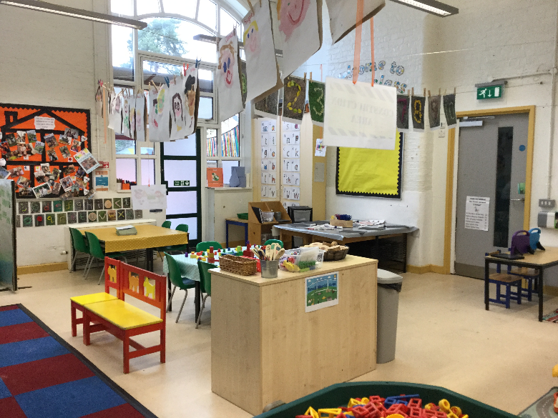

Slide 22
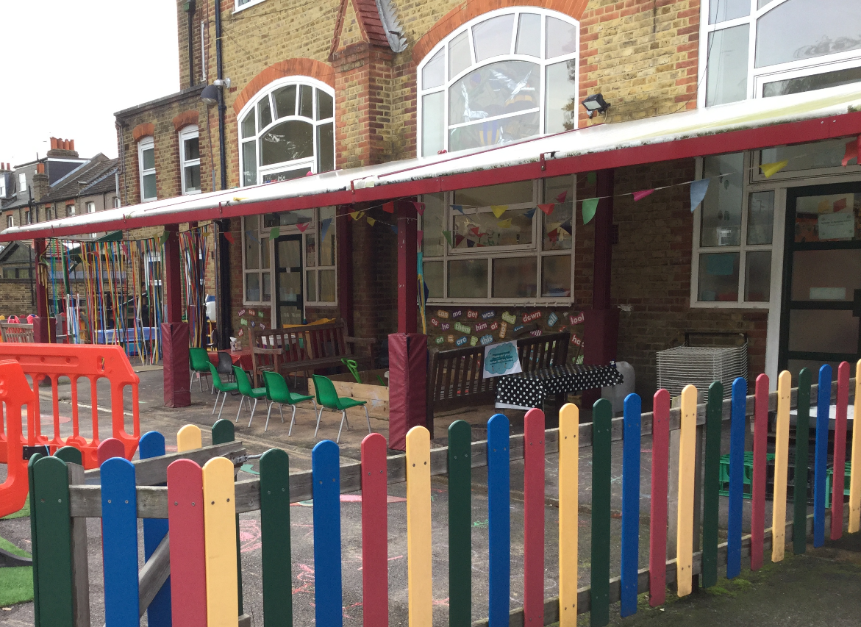

Slide 23
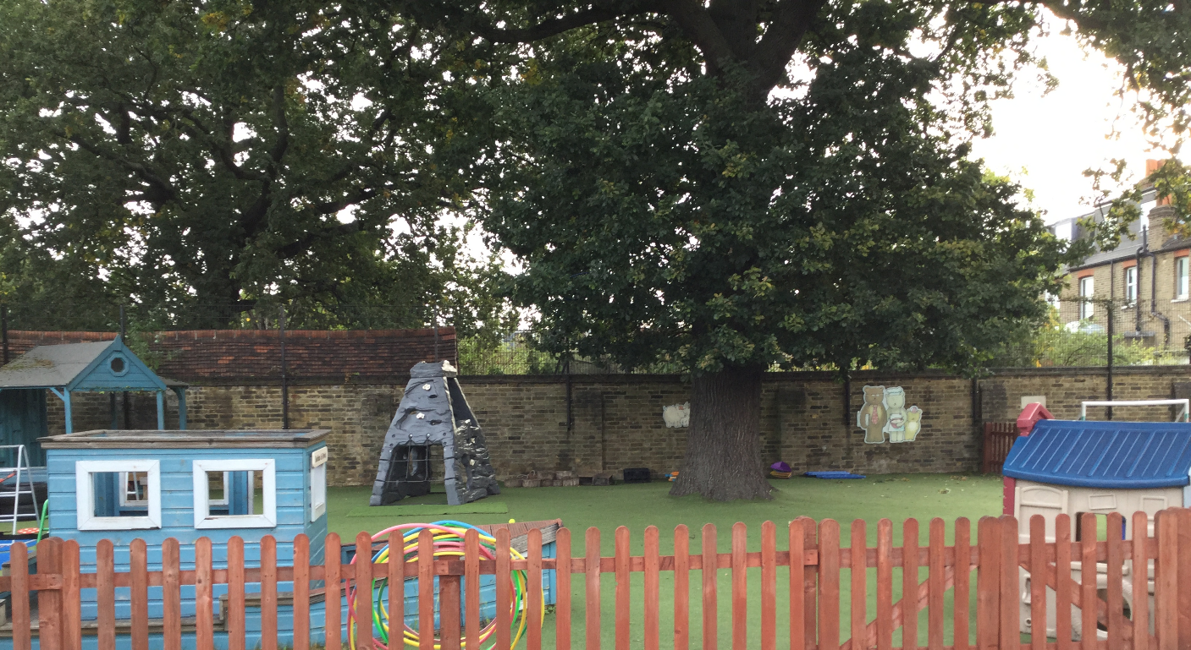

Slide 24
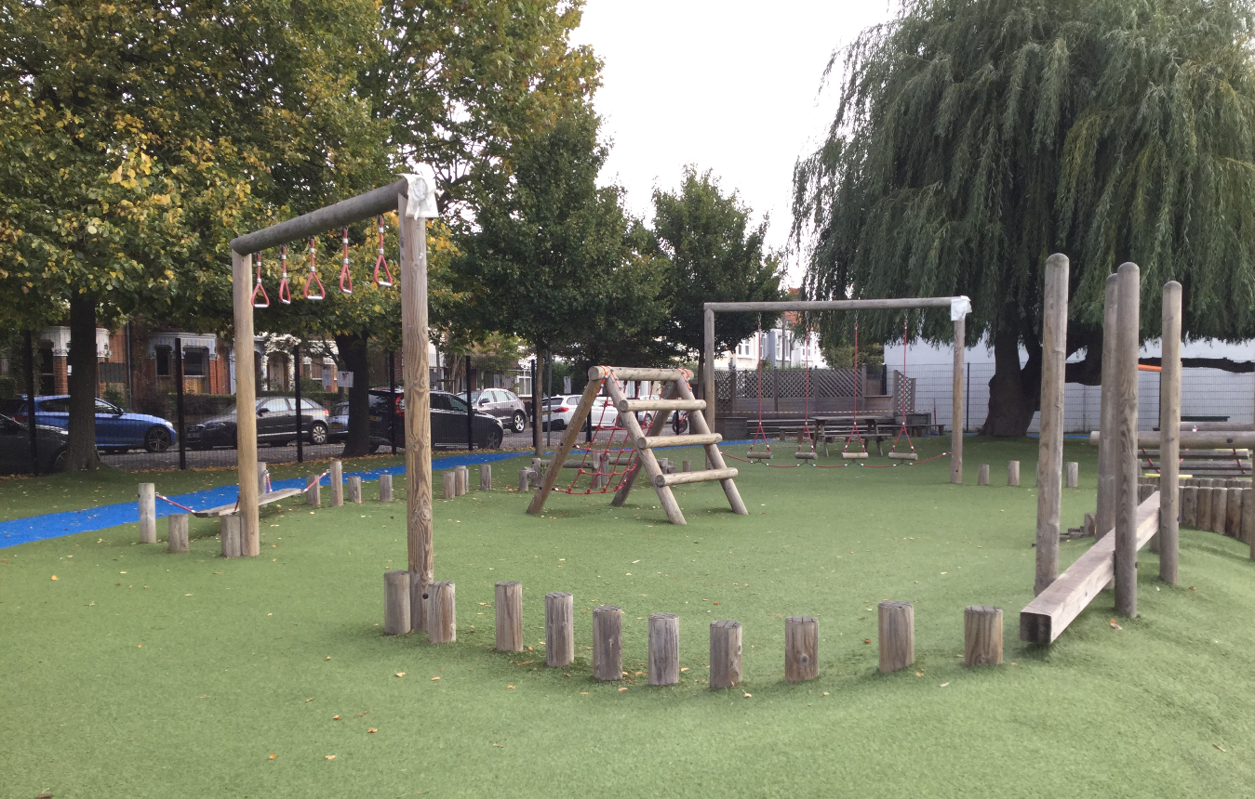

Slide 25
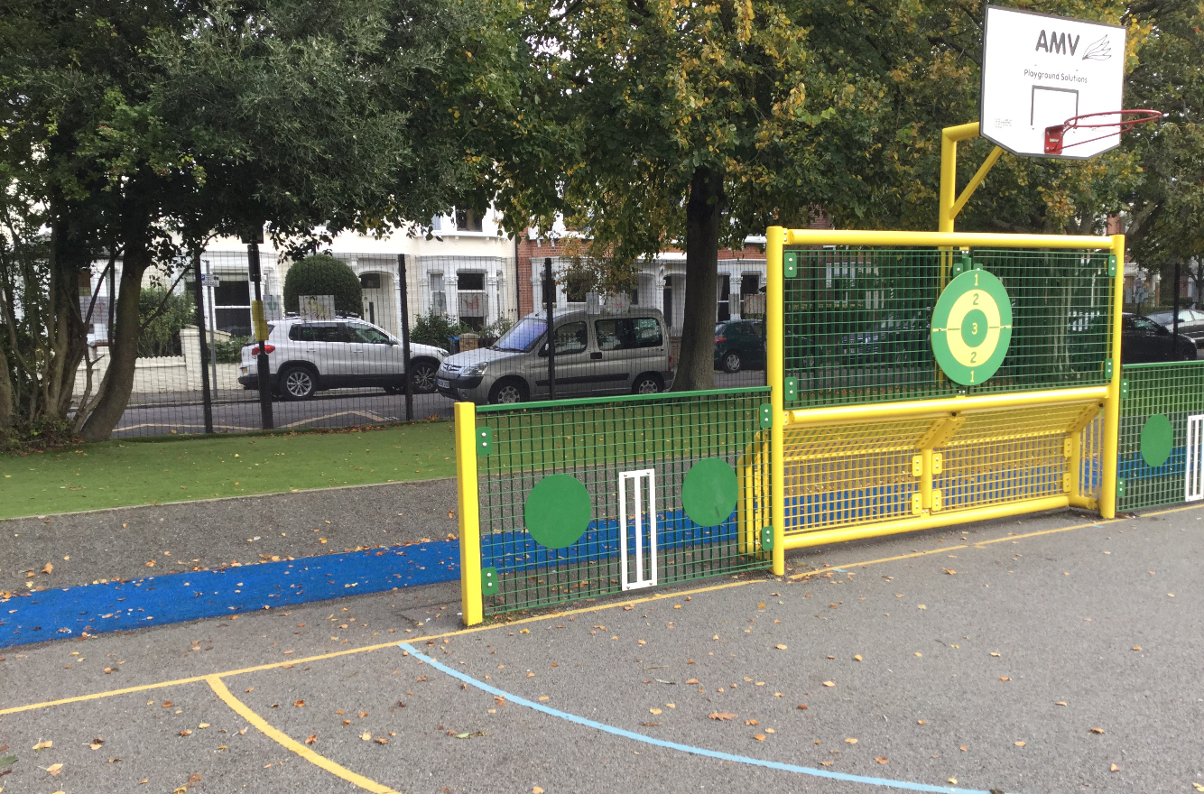

Slide 26
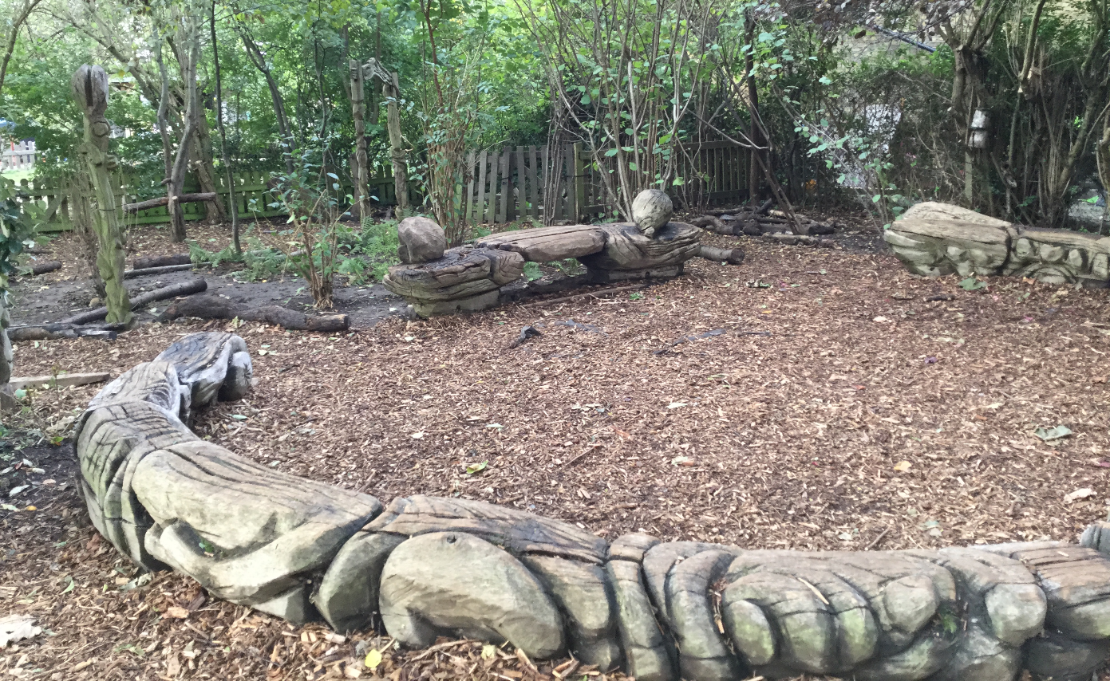

Slide 27
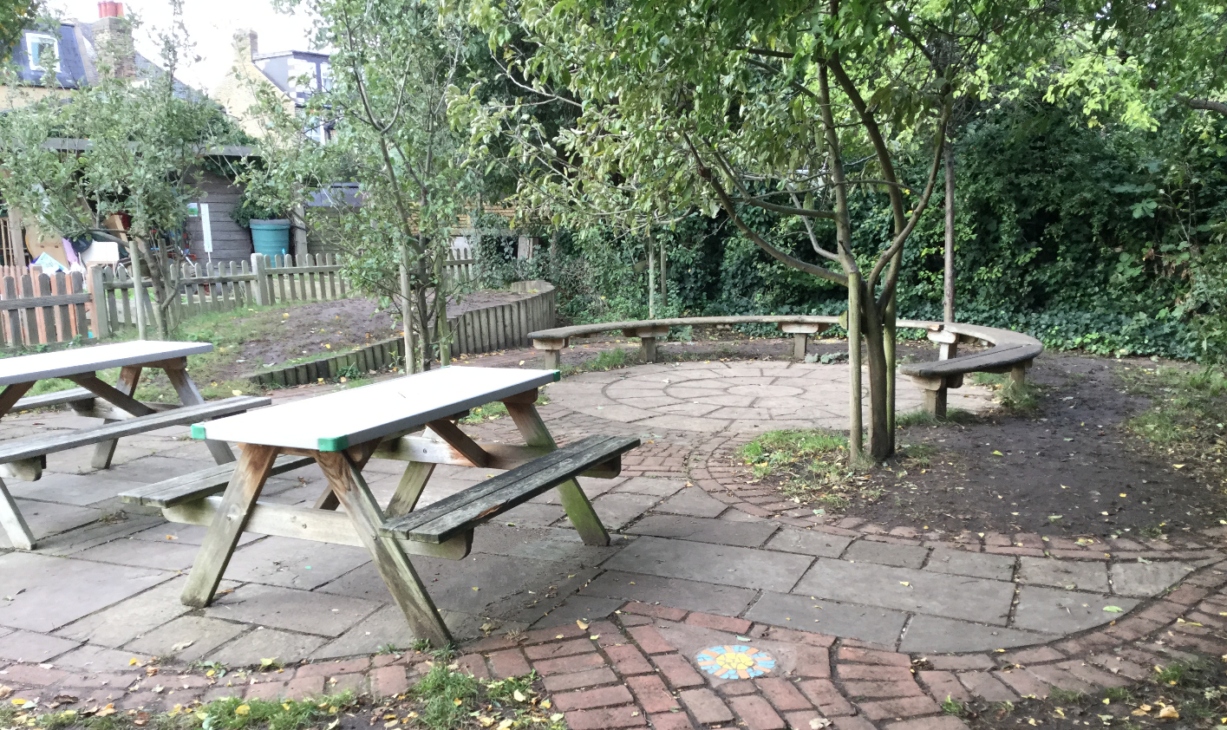

Slide 28
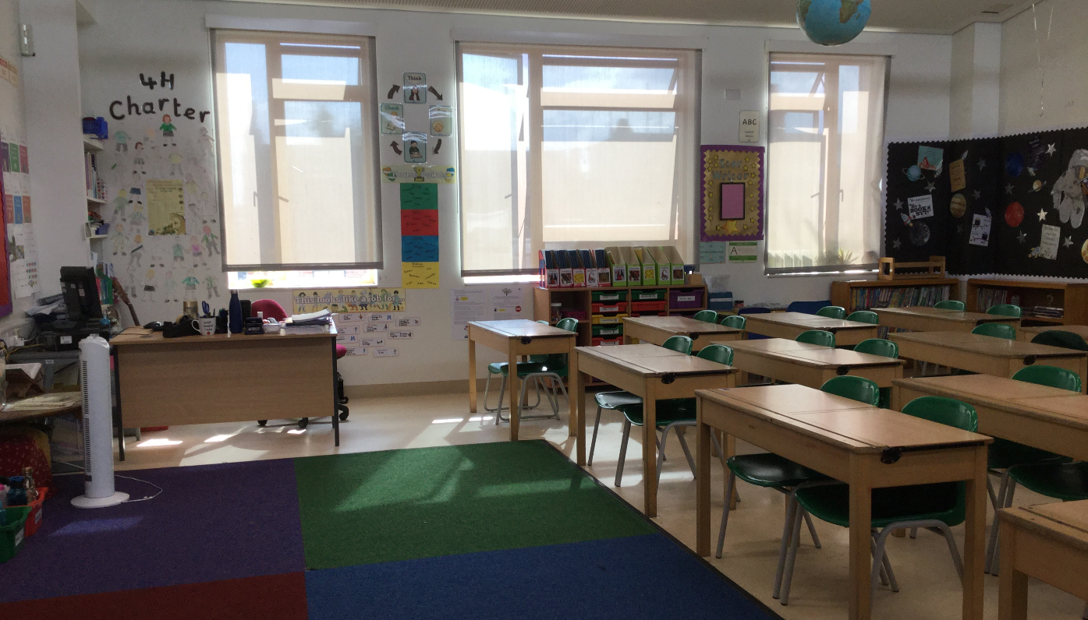

Slide 29
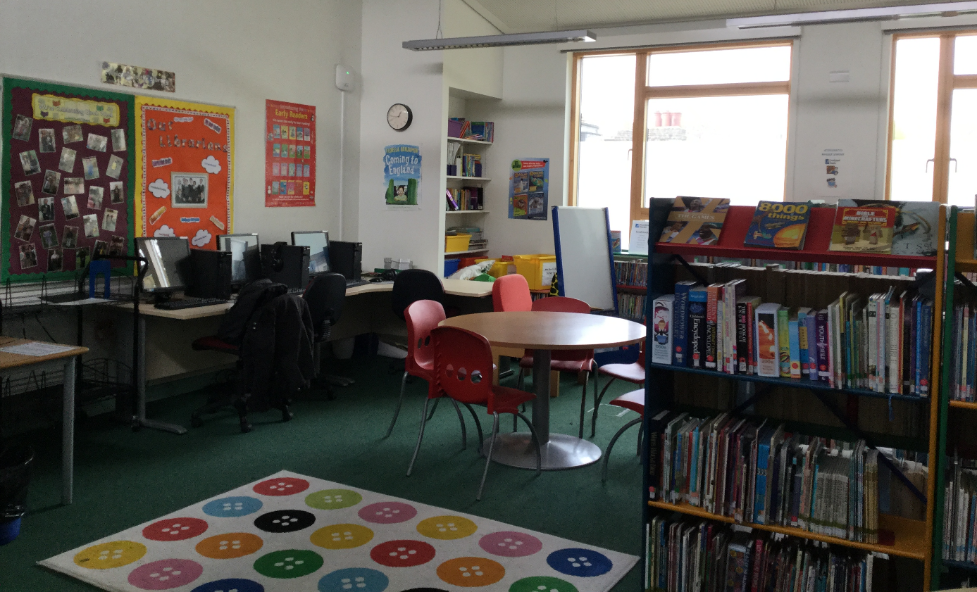

Slide 30
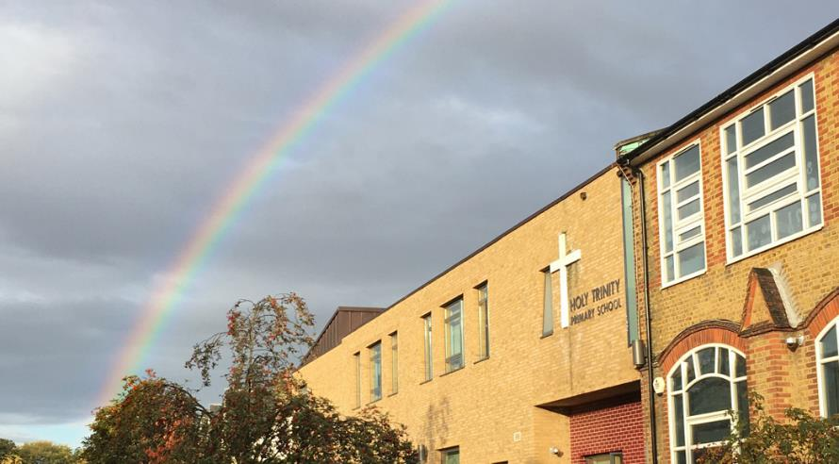
Thank you

