Slide 1
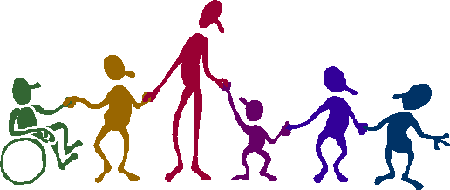
Year 5 Welcome Meeting
GROWING TOGETHER AS CHILDREN OF GOD

Slide 2
Year 5 Staff
5H
Class Teachers:
Mrs Gorynski (Monday – Wednesday)
kelly.gorynski@holytrinity.merton.sch.uk
Mrs Raincock (Thursday-Friday)
lisa.raincock@holytrinity.merton.sch.uk
5T
Class Teacher:
Miss Williams
lucy.williams@holytrinity.merton.sch.uk
Teaching Assistant:
Mrs Wyke
GROWING TOGETHER AS CHILDREN OF GOD

Slide 3
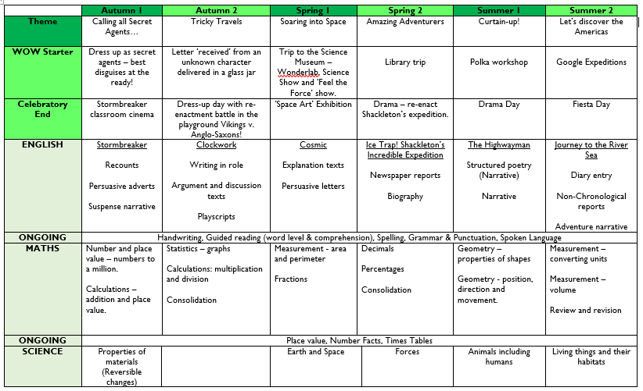
Long Term Plan
GROWING TOGETHER AS CHILDREN OF GOD

Slide 4
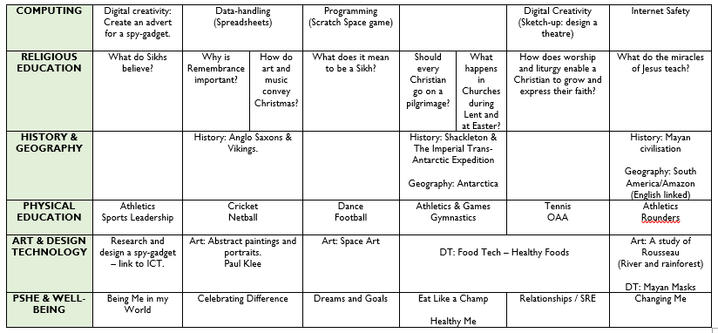
Long Term Plan (continued)
GROWING TOGETHER AS CHILDREN OF GOD

Slide 5
Proposed Visits/Visitors/Key Dates
Autumn Term
Spy secret agent day & mystery treasure hunt
Viking workshop and dress up day (8th November 2019)
Friday Afternoon Blues (FAB) workshop dates – 11/10, 18/10, 01/11, 15/11, 29/11, 06/12 (at KCS)
Spring Term
Science Museum trip (20th January 2020)
WWF workshop (TBC)
Sikh Gurdwara visit (TBC)
FAB workshop dates – 17/01, 31/01
FAB Final Performance at KCS – Friday 7th February 2020
Summer Term
Polka Workshop (TBC)
Fiesta Day
Wimbledon Library
GROWING TOGETHER AS CHILDREN OF GOD

Slide 6
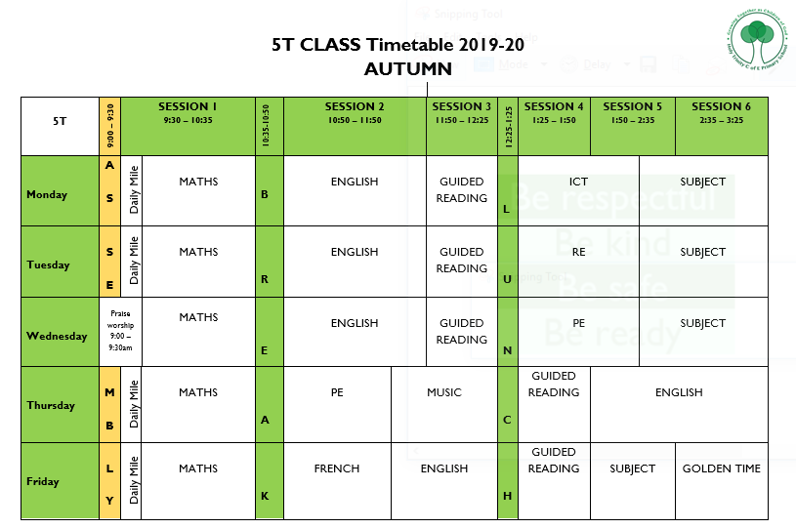
5T Timetable
GROWING TOGETHER AS CHILDREN OF GOD

Slide 7
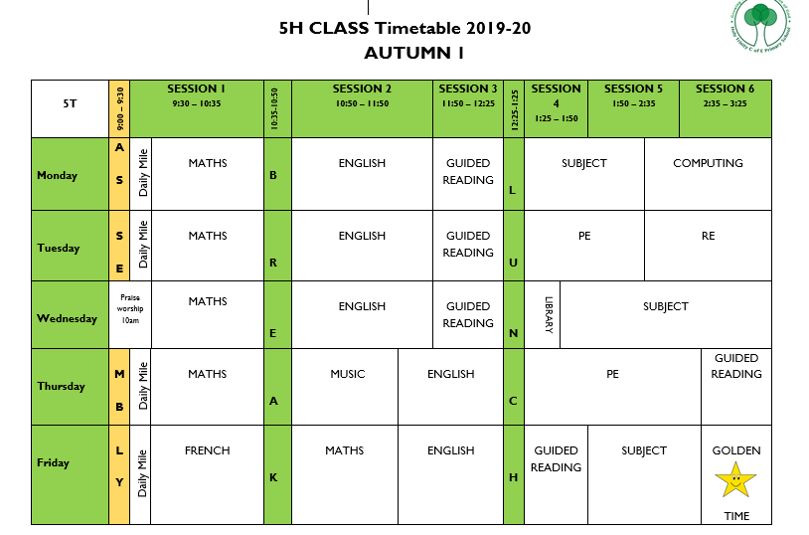
5H Timetable Autumn 1
GROWING TOGETHER AS CHILDREN OF GOD

Slide 8
Equipment
Pencil Case
HB pencils, sharpener, rubber, ruler, glue stick, colouring pencils and a black handwriting pen (Berol Handwriter or Frixion 0.7mm Rollerball, no biros please).
Water Bottle
School or plastic sports bottle filled with water (not juice please)
Fruit/Veg Snack
Break time snack to keep energy levels up
PE Kit
Indoor: black shorts, school house t-shirt, black plimsolls and socks
Outdoor: as above + black jogging bottoms
No jewellery to be worn in PE including stud earrings
GROWING TOGETHER AS CHILDREN OF GOD

Slide 9
Uniform
Please ensure that your child comes to school in the correct school uniform at all times and that it is all named.
No jewellery or nail varnish should be worn to school except for a watch and/or stud earrings.
GROWING TOGETHER AS CHILDREN OF GOD

Slide 10
Homework
English and Maths homework is set on a Friday and handed in on Wednesday.
Each task should take no more than 30 minutes. If your child has not completed the task during this time please do not worry.
Homework should be completed in homework books in pen or pencil (Maths/drawing). If they have been given a sheet, they should stick this into their books.
Sometimes children may require extra support with some concepts; in this instance they will be given extra tasks to support their learning at home.
If there are any problems with the homework please write a note in your child’s homework book or send an email to your child’s class teacher.
GROWING TOGETHER AS CHILDREN OF GOD

Slide 11
Reading
Children should be reading for at least 20 minutes each night.
Children can change their library books during their weekly free reading slot in Guided Reading. Quizzes can be taken on each day.
Depending on the length of your child’s books they may be encouraged to take two books from the library each week – one AR and one free reader.
We are continuing to use the Accelerated Reader Scheme this year; we encourage children to read a wide range of texts and anything that they read should be recorded in their reading records.
If your child does not like a book that they have chosen please feel free to return it to the library but encourage them not to give up too soon.
If your child does not want to read the whole book please feel free to take it in turns.
It is important that children see reading as a pleasurable experience; let them see you reading for pleasure!
GROWING TOGETHER AS CHILDREN OF GOD

Slide 12
Spelling
Practise common word spellings regularly; use strategies that work for your child to help them learn them e.g. look/cover/write/check, using for handwriting practice, flashcards…
Encourage children to think for themselves first before asking you to spell a word – remind of strategies they can use such as sounding the word out and thinking about other words they know.
Encourage the use of a dictionary.
When your child has finished their homework there is no need for you to correct all spelling mistakes but you could point out some spellings that you know they have been practising. Help children to spot their own spelling errors, encourage them to check when they have finished writing.
Play spelling games – board games, online games (e.g. through school website)
GROWING TOGETHER AS CHILDREN OF GOD

Slide 13
Behaviour
Positive behaviour will always be praised.
Children receive Golden Time on a Friday afternoon if they have behaved consistently well throughout the week.
Sometimes yellow and red cards will need to be used, this will always be in line with the Behaviour Policy.
Parents will be contacted if their child has received a red card.
Yellow and red cards are recorded in the classroom behaviour log.
GROWING TOGETHER AS CHILDREN OF GOD

Slide 14
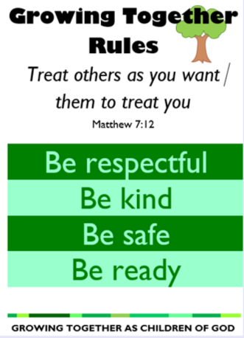
Behaviour
GROWING TOGETHER AS CHILDREN OF GOD

Slide 15
Questions
GROWING TOGETHER AS CHILDREN OF GOD

Slide 16
Thank you for your continued support
GROWING TOGETHER AS CHILDREN OF GOD

